Slide 1
Development of Cognition and Language: Vygotsky
EDU 330: Educational Psychology
Daniel Moos

Slide 2
Procedure
Sort the following words into whatever categories make sense and provide a label or rationale for each category.
males, females, figs, kangaroo, meat, dogs, honey, bees, the moon, cigarettes, water, sun, spear, wine, wind, fish, mud, fire, birds, rainbow

Slide 3
Compare
Compare your categories with the following created by aborigines in Australia…

Slide 4
Categories
Bayi: males, kangaroo, the moon, rainbow, fish, spear
Balan: females, dogs, birds, fire, water, sun
Balam: figs, honey, wine, cigarettes
Bala: meat, bees, wind, mud
myths and beliefs: rainbows are believed to be mythical men
experience: water extinguishes fire; myths and beliefs: birds are believed to be female spirits; dangerous and exceptional things are put in a minimally contrasting category: dogs are considered exceptional animals, so they appear in the second class instead of with men
experience: wine is made from fruit

Slide 5
Internalization
“Any higher mental function necessarily goes through an external stage in its development because it is initially a social function.”
Lev Vygotsky

Slide 6
Comparison of Piaget and Vygotsky
Piaget
Vygotsky
Role of Social Interaction
More strongly influenced by peers
More strongly influenced by those more intellectually advanced
Role of Instruction
Formal instruction does not have significant impact
Instruction important; zone of proximal development (ZPD)
Notes:
9

Slide 7
Vygotsky’s Theory: Assumptions (I)
1.”Child-in-activity-in-context” (unit of study)
  What is context?
    Social
    Cultural
    Historical
    -----“Mind” is socially distributed -----
  What is activity?
    Children behave in ways because they have needs/goals

Slide 8
Vygotsky’s Theory: Assumptions (II)
2. Zone of Proximal Development (ZPD):
Distance between actual development & higher level of potential development as determined under adult guidance or in collaboration with more capable peers
Issues with ZPD???

Slide 9
Vygotsky’s Theory: Assumptions (III)
Learning and Instruction with ZPD
Learning
  Natural byproduct of involvement in tasks with adults or more competent peers
  Vicarious Learning
  Private Speech: Thinking aloud
    Early years: End of task
    Later years: Beginning, during, and end of task
Instruction
  Scaffolding
  Fading

Slide 10
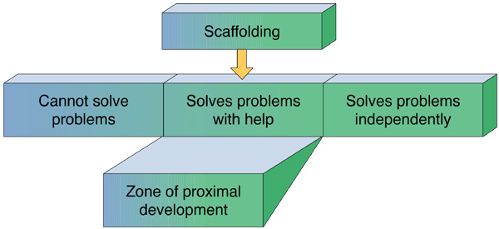
PowerPoint 2.13 The Zone of Proximal Development

Slide 11
Language: Suggestions for Teachers
Students cannot get too much practice in their use of language.
  Particularly true in math and science
Remind students that struggling to put understanding into words is a normal part of learning and development.
  We’ve all said at some point in our lives. I know what I’m trying to say, I just can’t put it into words.
Provide students with scaffolding as they practice language.
  Provide technical terms
  Embellish students’ descriptions

Slide 12
Evaluation of the Theory
Strengths
  Attention of social, cultural, and context variables in learning
  Sensitivity to diversity of development
  Focused on individual differences (unlike Piaget)
Weaknesses
  Vagueness of notion of ZPD
  Insufficient attention to development issues
  Difficulties of studying cultural-historical contexts

Slide 13
Language: Stages
Building the foundation
  Holophrases: “No go!”
  Overgeneralizations: “Car”
  Undergeneralizations: “Kitty”
Fine-tuning language
  Fine-tune during the “twos”, during which children elaborate on present tense: “I eating”
Increasing language complexity
  Children begin to use sentences more strategically (age of 3)
  Ability to form more complex sentences occurs (age of 6)

Slide 14
Language: Theories of Language Acquisition
Sociocultural
  Language development facilitated when adults adjust speech to operate within child’s ZPD
Nativist
  Asserts that all humans “wired” to learn language; exposure to language triggers this development
Behaviorist
  Explains language development through reinforcement of demonstrating good sounds and words
Social Cognitive
  Emphasizes role of modeling, imitation, adult reinforcement, corrective feedback

