Slide 1
Flipping the Classroom:
Embedding Self-Regulated Learning Prompts in Videos
Daniel C. Moos, PhD

Slide 2
Introduction to Flipped Classrooms (I)
“…what is traditionally done in class is now done at home, and that which is traditionally done in home is now completed in class”
Bergmann & Sams, 2012, pg. 13

Slide 3
Introduction to Flipped Classrooms (II)
Nonlinear:
Student control pacing of content delivery: Meet individual cognitive needs
Multiple representations:
Dual Coding Theory: Auditory and visual channels
Learning Styles (visual, auditory)
Class time:
Increased opportunity for collaborative activities
Potential
Benefits
Are these benefits realized?
Mixed findings on learning product, limited research on learning process

Slide 4
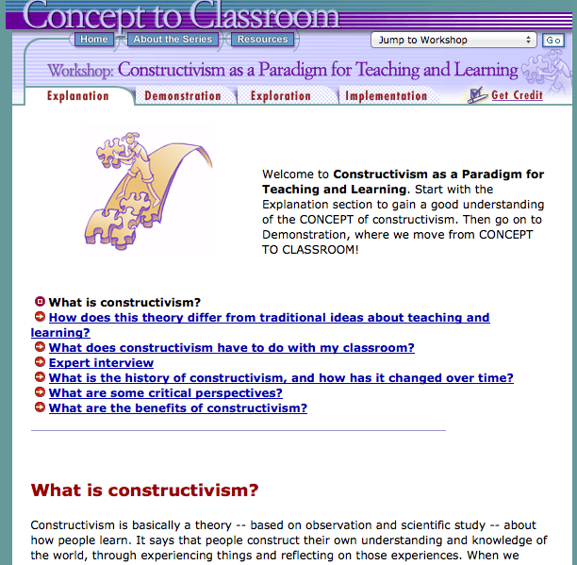
Context: Hypermedia Learning
Non-linear
Multiple
Representations

Slide 5
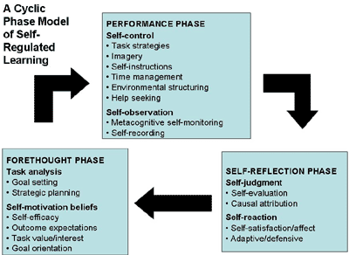
Theoretical Frameworks
Social Cognitive Approach (Zimmerman, 2000)

Slide 6
Summary of past research
SRL highly predictive of learning outcomes in variety of contexts with various developmental groups (Bembenutty, 2011; Butler, Cartier, Schnellert, 2011; Cleary & Sandars, 2011; Cleary & Platten, 2013; DiBenedetto & Bembenutty, 2013; McPherson & Renwick, 2011; Schunk & Zimmerman, 2013)
….particularly true with hypermedia (Azevedo et al. 2010, 2011, 2012; Greene et al. 2013; Moos, 2010, 2013, 2014)
Many students, including undergraduates, do not adequately self-regulate their learning (Moos & Stewart, 2013)
Videos share inherent design features with hypermedia: Nonlinear; Multiple representations…
Similar SRL challenges when learning with a video designed for a flipped classroom?
Can embedded SRL scaffolds facilitate learning?

Slide 7
Designing effective videos with SRL prompts
Start video with Intended Learning Outcome (backwards design)
By watching this video, you should be able to: Identify (start with a verb)
Planning Phase:
What do you already know about ___________ ?
What questions do you have about ___________ ?
Monitoring Phase:
What information have you learned so far?
Is there anything presented so far that you do not understand?
Reflection Phase:
What did you learn about motivating students?
What questions do you have about the information presented?
Do you need to go back in the video and fill any gaps in understanding?

