Slide 1
Effective use of Technology

Slide 2
Flipping the classroom?
4 minutes to….
Describe a flip classroom (characteristics and rationale)
Benefit?
Challenges?
Practicality?
“Sure, some subjects naturally take on the flip…”
“…there are subjects that don’t align with being a part of a flipped classroom because they generally are more discussion based: history, reading…” JR

Slide 3
Flipped classroom in elementary school (I)
Start small!
Identify the goal;
Accessibility to videos;
Integrate assessment;
Use existing videos;
http://www.khanacademy.org
http://streaming.discoveryeducation.com
http://www.mathpickle.com/K-12/Videos.html
Personalize videos;
Trial and error;
Model expectations and learning with a video. How?

Slide 4
Flipped classroom in elementary school (II)
“Active” vs. “Passive” learning with video (and any other instructional material, for that matter)?
“Passive” reading = reading straight through without stopping (different than learning to read; objective is comprehension)
“Active” reading = ???
“Passive” engagement with video = ???
“Active” engagement with video = ???

Slide 5
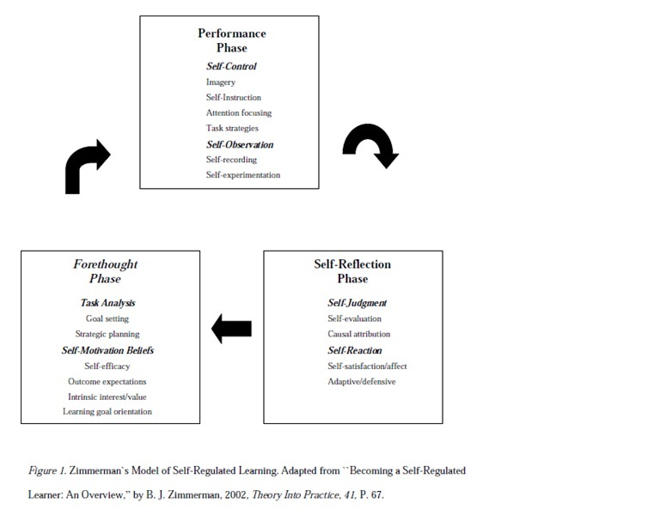

Slide 6
Flipped classroom in elementary school (III)
Forethought (planning) phase:
What do you already know about________ ?
What question do you have about ________ ?
What strategies do you think will be effective ________ ?
Performance (monitoring) phase:
What information have you learned so far?
What question do you have about _______ and/or is there anything you do not understand?
How effective have your strategies been in learning ________ ?
Self-reflection phase
What did you learn about________ ?
What question do you have about _______ and/or is there anything you do not understand? ________ ?
Do you need to go back in video and fill in any gaps of understanding?
What would you have done differently while learning about _______ ?

Slide 7
Flipped classroom in elementary school (IV)
Creating videos:
Department cameras
QuickTime: Movie
QuickTime → File → New Movie Recording
QuickTime: Screen Recording
QuickTime → File → New Screen Recording
Make sure audio is activated! Click down arrow and select built-in mic

Slide 8
Flipped classroom in elementary school (V)
Editing videos
iMovie
Uploading videos to YouTube
www.youtube.com
Sign in with Gustavus email/password (upper right)
Request option to upload videos longer than 15 minutes
Upload video (upper right)
Select “unlisted”
Click and drag file or select file
Making video accessible
Copy address from uploaded YouTube video
Create link within your personal website (google sites)

Slide 9
Technology Review (I)
Kidspiration….why?
Association exercise: Minnesota
Cold
Ice Cream
Moose Tracks
Ice House
Summer
Alarm clocks
5 am
Peaceful
Coffee
→ Who has a word for the association exercise?

Slide 10
Technology Review (II)
Linguistic
Ability to use language
Garageband….why?
Logical
Reasoning, numbers, symbols
Musical
Sensitivity to pitch, tone
Spatial
Perceive words accurately
Kinesthetic
Ability to use body coordinated movements
Interpersonal
Understanding of social interactions
Intrapersonal
Understanding of self
Naturalistic
Recognize similarities/diff in physical world

