Slide 1
Electronics and Signal Processing in Four Parts
Stoll, Che380
Part I – Basic Electronics

Slide 2
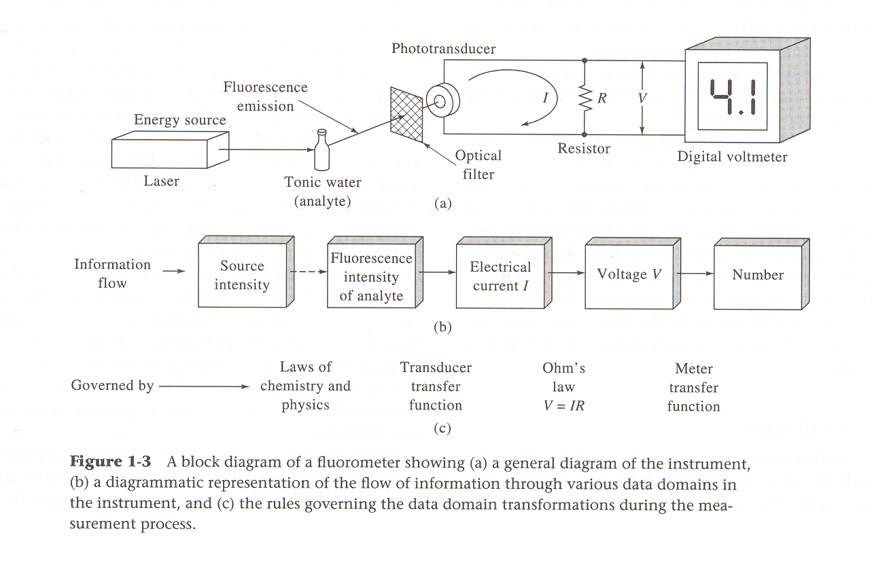
Skoog, Holler, Crouch, 7th Ed.

Slide 3
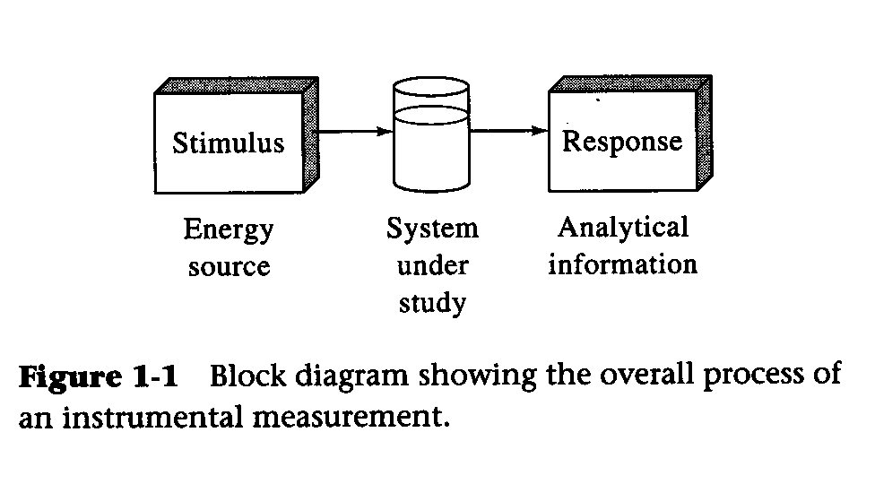
Skoog, Holler, Crouch, 7th Ed.

Slide 4
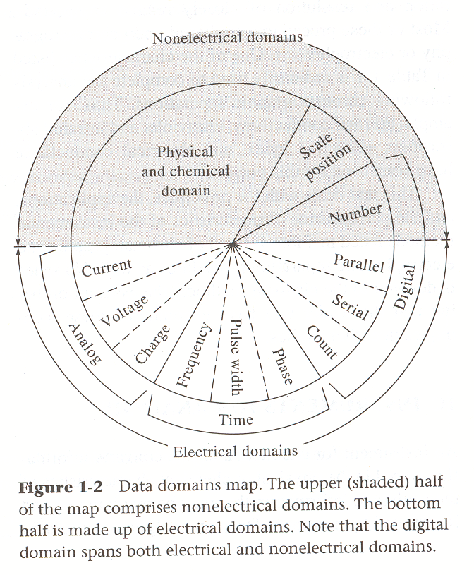
Skoog, Holler, Crouch, 7th Ed.

Slide 5
Skoog, Holler, Crouch, 7th Ed.

Slide 6
Some objectives for our study of electronics and signal processing…
Be able to define ‘the four laws’ and apply them to explain the behavior of an electrical circuit (Power Law, Ohm’s Law, and Kirchoff’s Current and Voltage Laws)
Be able to explain, in quantitative terms, the problems that arise in measuring small currents and voltages in instrumentation
Be able to explain the valuable characteristics of operational amplifiers for use in instrumentation, and describe the specific circuits used for current and voltage measurements
Be able to describe circuits used for signal processing in the analog domain, and predict their behavior in quantitative terms
Be able to describe approaches used for signal processing in the digital domain, and prescribe a particular approach when presented with a real instrument signal
Be able to describe the characteristics of an analog-to-digital converter, in quantitative terms
Be able to describe the concept of Fourier analysis, by showing the relationships between a raw analog signal, a power spectrum, and a reconstructed signal produced using an inverse Fourier transform

Slide 7
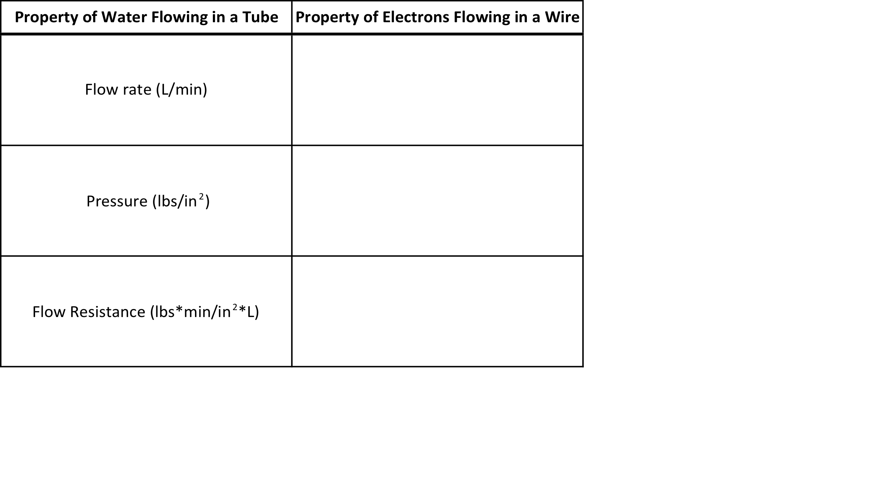
Complete the following table (including units):

Slide 8
For each of the following, write down both an equation and a statement that describes the meaning of the law.
Power Law
Ohm’s Law
Kirchoff’s First Law
Kirchoff’s Second Law

Slide 9
What is the equivalent property of each of the following?
Two voltage sources connected in series; in other words what is the equivalent voltage if these two elements were replaced by a single voltage source?
Two resistors connected in series.
Two resistors connected in parallel.
Two voltage sources connected in parallel.

Slide 10
The H₂O vs. e⁻ analogy…
e⁻ in a wire
H₂O in a pipe
Current (1 amp= 1 coulomb/s = 6.2*10¹⁸ electrons/s).
Voltage ( 1 volt = 1 joule/coulomb)
Resistance (1 ohm = 1 volt/amp) resistance increases with decrease in wire diameter and increase in wire length
Flow rate (e.g. gal/sec)
Pressure (e.g. lbs/sq. inch, atm.)
Flow resistance (pressure/unit flow)
resistance increases with decrease in pipe diameter and increase in pipe length
Mod. PWC 4101

Slide 11
Rubinson, K.A. and J.F. Rubinson, Contemporary Instrumental Analysis. 2000, Upper Saddle River: Prentice Hall.

Slide 12
Electronics and Signal Processing in Four Parts
Stoll, Che380
Part II – Measurment Errors and Operational Amplifiers

Slide 13
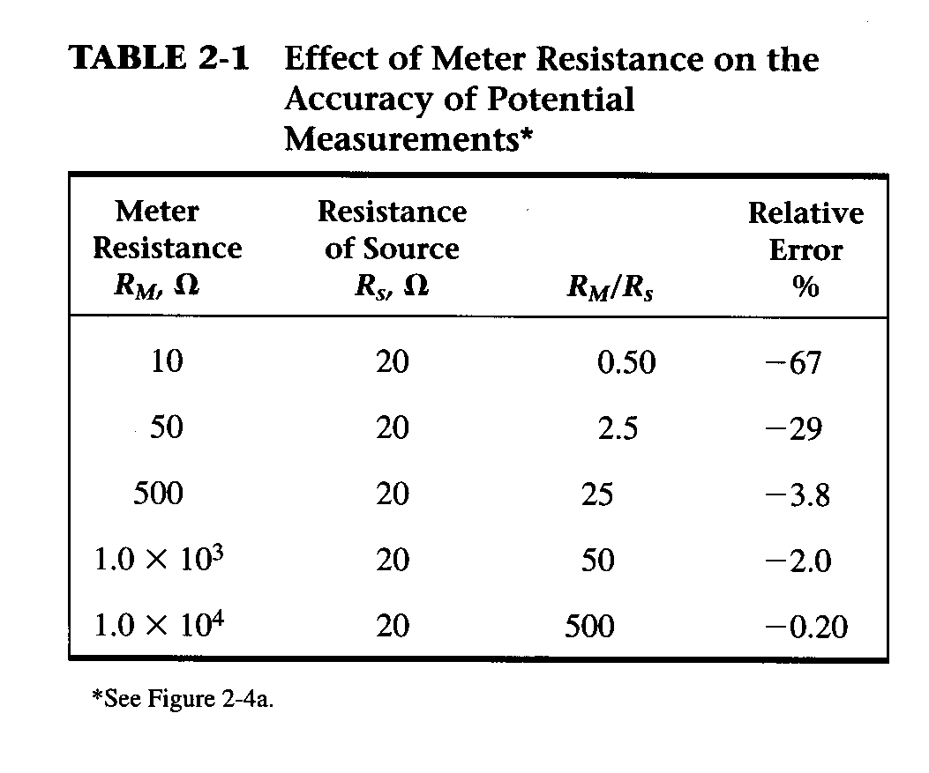
Skoog, Holler, and Crouch, 7th Ed.

Slide 14
Schematic of a Glass pH Electrode with Ag/AgCl Reference Electrodes
‘Outer’ Reference Electrode
Salt Bridge, or, Liquid Junction (Porous Plug)
‘Inner’ Reference Electrode
Glass Membrane
-
-
Ag_{(s)}
H⁺
H⁺
Ag⁺
-
-
Cl⁻
Ag_{(s)}
AgCl_{(s)}
Analyte Solution – Unknown [H⁺]
H⁺
H⁺
-
-
AgCl_{(s)}
Ag⁺
H⁺
Cl⁻
-
-
[H⁺], [Cl⁻] ~ 1 M
K⁺
H⁺
H⁺
-
-
E₁
E₂
E₃
E₄
E₅
Voltmeter
(+) or (-)
Stoll, SOC, 2005

Slide 15
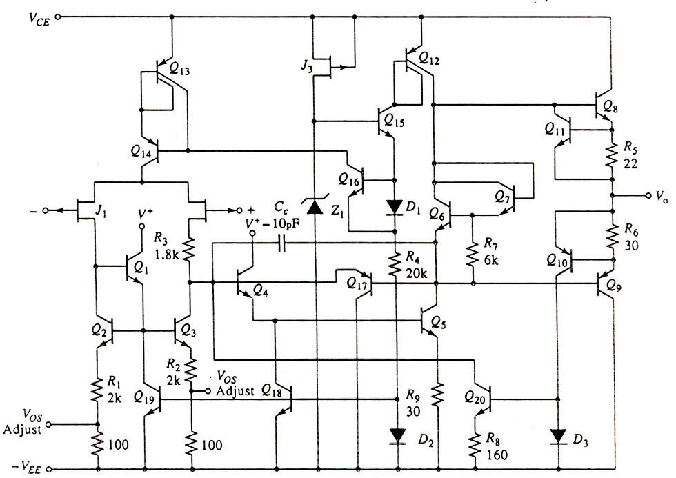
Wiring of “Simple” 741 Op-Amp
+15 volt power
Positive signal input (v₊)
Negative signal input (v₋)
Output v_{out}
-15 volt power
Horowitz and Hill, Figure 3-3

Slide 16
What are three performance characteristics of operational amplifiers that make them particularly useful in analytical instrumentation?
What does the word ‘operational’ in ‘operational amplifier’ imply about the ways op-amps can be used?

Slide 17
What is the most important performance characteristic of a ‘voltage follower’ circuit? In what type of instrument might such a circuit be useful?
What is the most important performance characteristic of a ‘current follower’ circuit? In what type of instrument might such a circuit be useful?

Slide 18
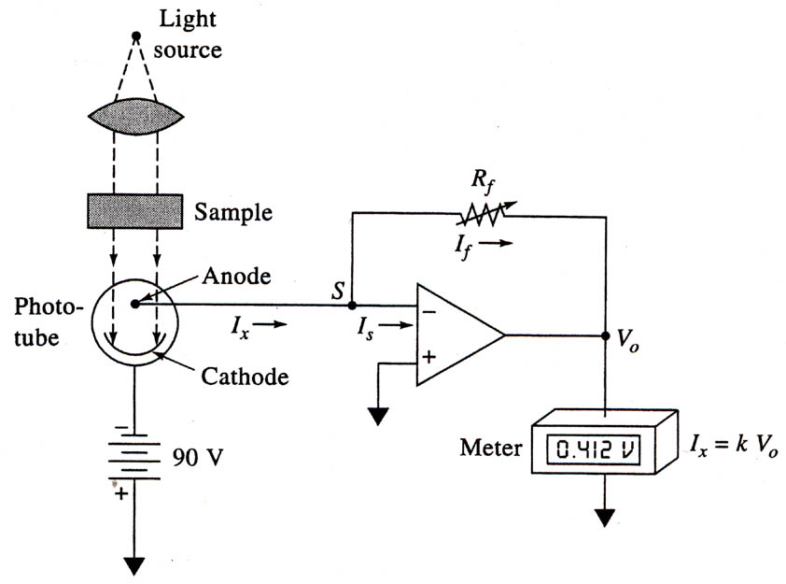
Skoog, Holler, Crouch, 7th Ed., Fig. 3-10

Slide 19
Simple Single Transistor Amplifier
Ordinarily, α = 0.95 to 0.995 and β = 20 to 200.
Fundamentally transistors are current amplifiers thus small changes in I_{B} give big changes in I_{C}
Skoog, Holler, Crouch, 7th Ed., Fig. 2-18

Slide 20
Electronics and Signal Processing in Four Parts
Stoll, Che380
Part III – Analog Filtering and A/D Conversion

Slide 21
Key Concepts for RC Circuits and Analog Filtering
Time Constant, Cutoff Frequency – calculation and significance
How do we ‘use’ a RC circuit – where do we measure V_{out}?
Gain and Bode plots for RC filters – calculation and significance
Passive vs. Active analog filters – what is the difference, both in terms of construction and performance?
Negative impact of RC filtering

Slide 22
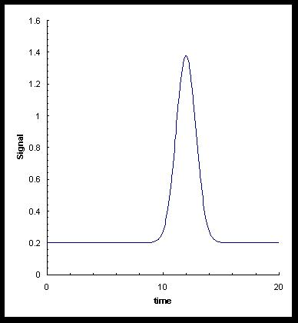
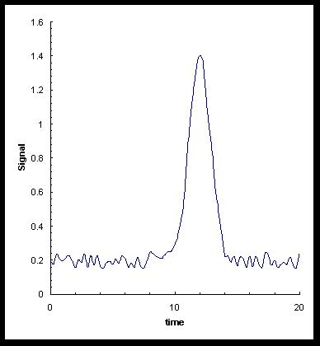
Signal vs. Noise-Welcome to the Real World!
What we want to see…
What we do see…
PWC 4101-06

Slide 23
What you want an IDEAL “noise reducer” to do.
Before filtering
After filtering
PWC 4101-06

Slide 24
Draw the schematic of a simple circuit (no amplifiers) that can be used as a ‘low-pass’ analog filter.
Draw the schematic of a simple circuit (no amplifiers) that can be used as a ‘high-pass’ analog filter.

Slide 25
Calculate the time constant and cutoff frequency for a circuit composted of a 1 kΩ resistor and a 20 μF capacitor connected in series.
Construct a plot that shows the output voltage from a low-pass RC filter as a function of time in response to a step change in the input voltage from 1 to 0 V. Assume the circuit has a time constant of 1 sec.

Slide 26
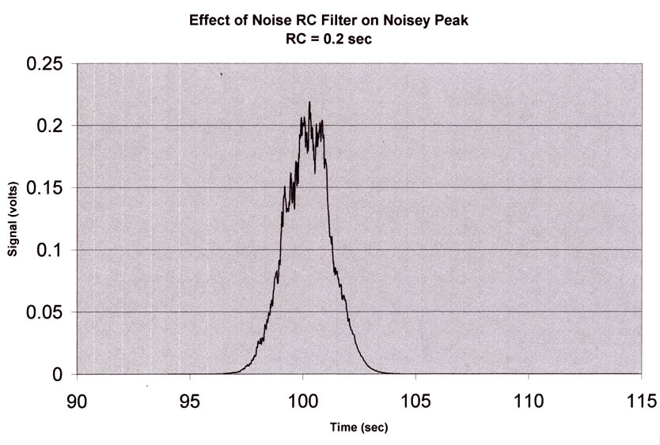
Gaussian Peak + Random Short-Term Noise + Low-Pass RC Filter with RC TOO SMALL
PWC 4101-06

Slide 27
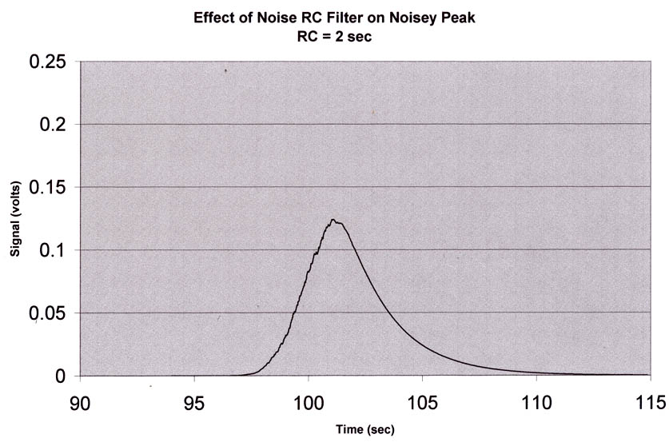
Gaussian Peak + Random Short-Term Noise + Simple RC Filter
PWC 4101-06

Slide 28
Signal vs. Noise-Welcome to the Real World!
What we want to see…
What we do see…
PWC 4101-06

Slide 29
What you want an IDEAL “noise reducer” to do.
Before filtering
After filtering
PWC 4101-06

Slide 30
Gaussian Peak + Random Short-Term Noise + Low-Pass RC Filter with RC TOO SMALL
PWC 4101-06

Slide 31
Gaussian Peak + Random Short-Term Noise + Simple RC Filter
PWC 4101-06

Slide 32
Horowitz and Hill, Art of Electronics

Slide 33
Rubinson and Rubinson Contemporary Instrumental Analysis

Slide 34
What is the decimal equivalent of the following binary number? – 011010
Suppose the full output range of your UV detector is 1 V. What is the smallest signal that be detected following digitization of the analog signal using a 8-bit A/D converter? How does change if you using a 24-bit converter?

Slide 37
Electronics and Signal Processing in Four Parts
Stoll, Che380
Part IV – Digital Filtering and Fourier Analysis

Slide 38
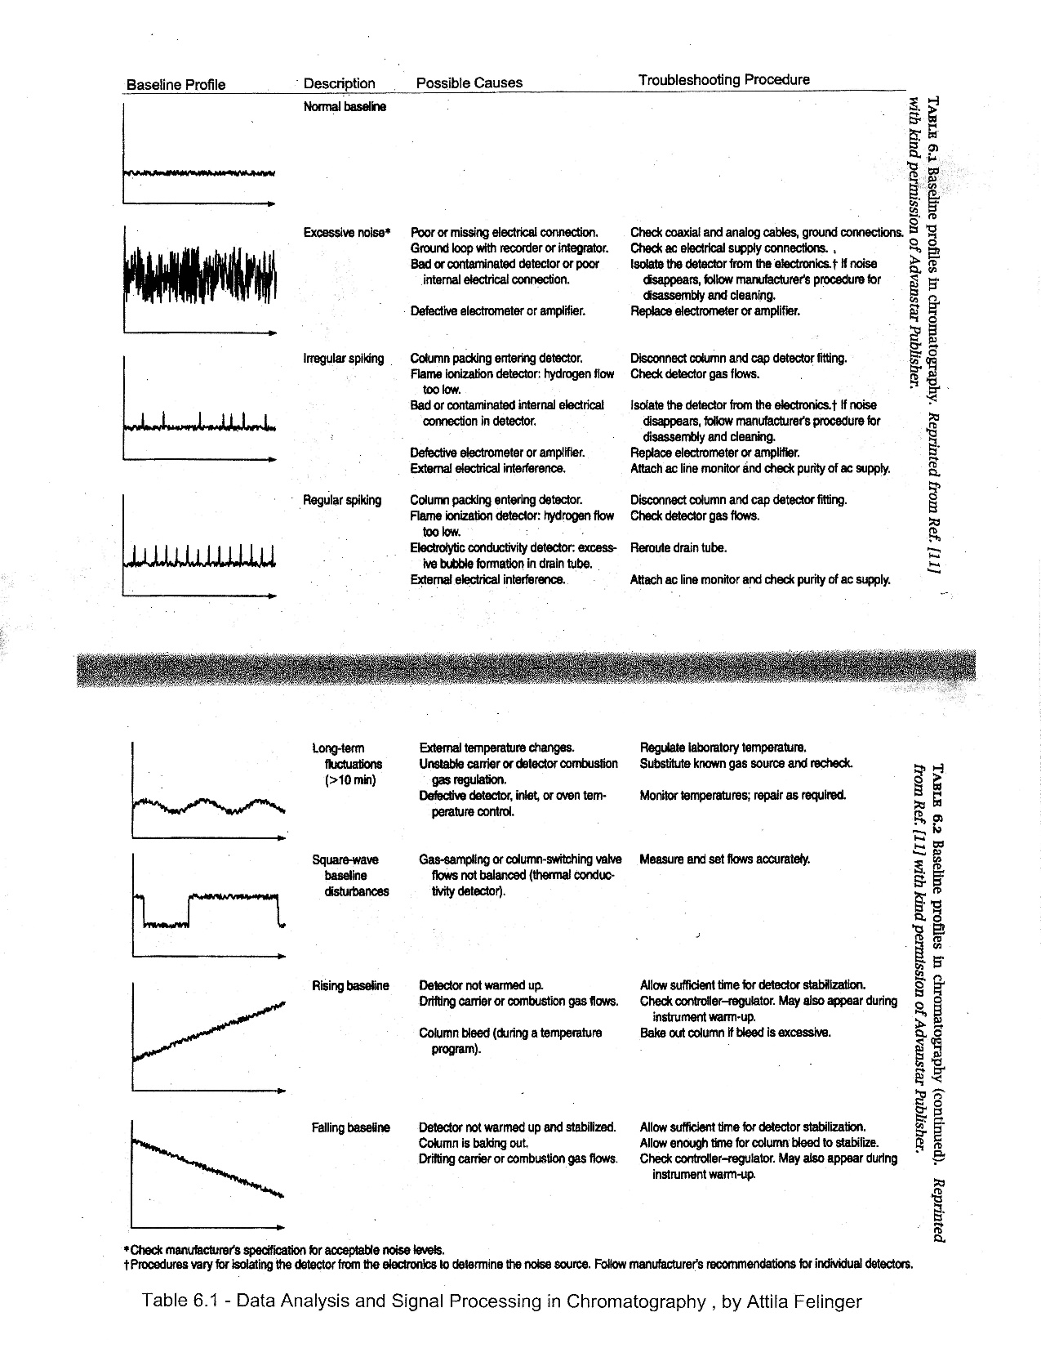

Slide 40
Skoog, Holler, Crouch, 7th Ed., Fig. 5-10

Slide 41
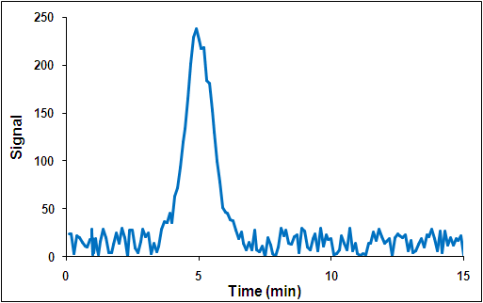
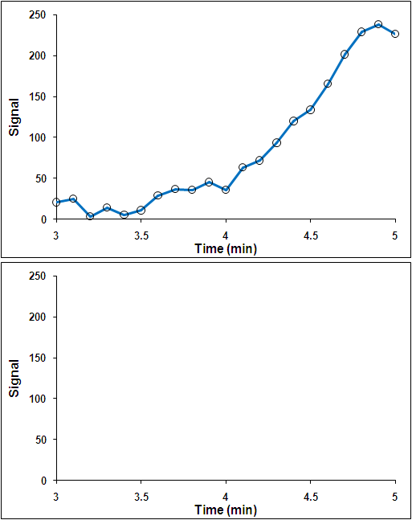

Slide 42
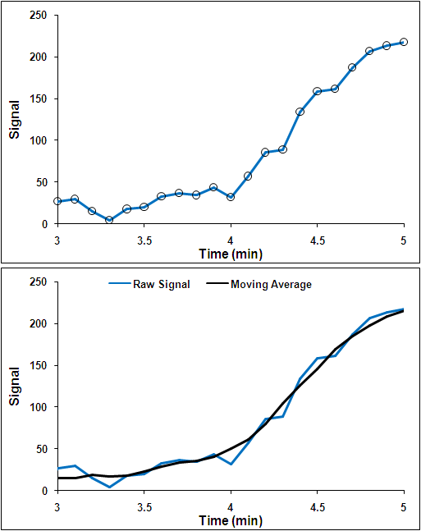

Slide 43
Noisey Input
PWC 4101-06

Slide 44
5 Point Moving Average Smooth Output
PWC 4101-06

Slide 45
11 Point Moving Average Smooth Output
PWC 4101-06

Slide 46
Representation of a Square Wave by a Series of Sine Waves
Fig. 17.11 Rubinson and Rubinson Contemporary Instrumental Analysis

Slide 48
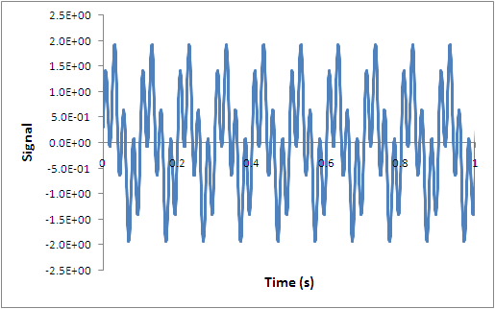
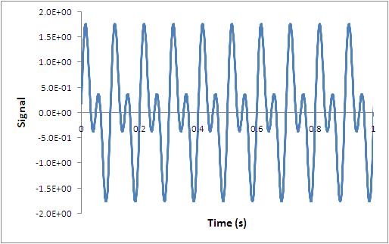
Original Signal (Analog)
Reconstructed Signal (Digital)

Slide 49
Skoog; Holler; Crouch Principles of Instrumental Analysis, 6th ed.; Thomson Brooks/Cole, 2007.

Slide 50
The Interferometer
Fixed Mirror
White Light
Laser
Linear Drive Motor
Moving Mirror
IR Source
Beam Splitters
White Light Detector
Laser Detector
IR Detector
Slide courtesy of S. Asher, U Pitt

Slide 51
Photon Interference
• A photon is “split” and travels down the two legs of the interferometer, reflects off the two mirrors, returns to the beam splitter, is “recombined” and reflected off towards the detector. By recombining, the two “photon-parts” interfere with each other. If the paths taken are identical, or are different by a integral number of wavelengths, then constructive interference occurs. The photon has a probability of 1 of heading off to the detector.
• If the paths differ by exactly 1/2 of a wavelength of the light, the two parts will destructively interfere and the photon has a probability of 0 of coming out and heading to the detector.
• Any other path difference, the photon has a probability between 0 and 1 of reaching the detector.
• The detector does not know about interference; any photon that reaches it deposits energy that gives rise to a signal. The sum of a large number of photons, each one having been subjected to an interference event, constitutes the signal reaching the detector at any point in time.
Slide courtesy of S. Asher, U Pitt

Slide 52
Monochromatic Light
• consider a monochromatic light source. For a given path difference, the output beam’s intensity is given by the probability of a given photon making it through.
• the path difference is continually changing because the moving mirror is being scanned.
• record the detector intensity vs. time. Note that time is directly correlated to mirror position by the scan velocity, which corresponds directly to any path difference.
Signal (power)
time
N.B. Don’t confuse this wavelength with the wavelength of the light.
Slide courtesy of S. Asher, U Pitt

Slide 53
FTIR is a Multiplex Experiment
When a spectrometer uses an array detector, it has a large number of similar detectors functioning simultaneously. It is a multichannel detection system. By contrast, the FTIR encodes the many channels with different frequencies and they impinge upon the same detector simultaneously. It is a multiplex experiment.
multichannel
multiplex
Slide courtesy of S. Asher, U Pitt

Slide 54
Bichromatic Light
• when two light wavelengths traverse the interferometer, both come in and out of phase with themselves, but they do so at different times because of the different wavelengths involved.
higher frequency
time
Slide courtesy of S. Asher, U Pitt

Slide 55
Detector Sees the Sum
• the detector sees the sum of the power delivered by the two beams. When both have a maximum power, then the signal is doubled; when both are at a minimum, the signal is at a minimum. When one is at a maximum and the other at a minimum, the power is in the middle.
time
Slide courtesy of S. Asher, U Pitt

Slide 56
Then One is Absorbed
• then a sample is placed in the beam; it has the property that it has a certain probability (let’s say 50%) of absorption of the higher frequency photon. The beat pattern changes due to the preferential absorption of the one frequency.
time
Slide courtesy of S. Asher, U Pitt

Slide 57
The Frequency Domain
• the detector observes and reports the variation of photon power in time arriving at the detector. Such a graph of time vs. power is said to be a time domain representation of the data.
• the spectrum with which we are more familiar is that which reports the relative amplitude of each contributing signal.
no sample
absorbing sample
relative power
frequency or energy
frequency or energy
Slide courtesy of S. Asher, U Pitt

