Slide 1


Spatial distribution of acoustic radiation force modal excitation from focused ultrasonic transducers in air
Acoustical Society of America Meeting
Boston, MA
June 26, 2017
Thomas Huber, Ian McKeag, William Riihiluoma
  Physics Department, Gustavus Adolphus College
Christopher Niezrecki, Songmao Chen, Peter Avitabile
  Mechanical Engineering, University of Massachusetts, Lowell

Slide 2
Introduction
Overview Acoustic Radiation Force for Modal Excitation in Air
Excitation using two transducers in X-Focal arrangement
Excitation using single transducer with amplitude modulation
  Utilization to Determine Ultrasound Distribution from Transducer
Excitation using confocal transducer
Conclusions

Slide 3
Acoustic/Ultrasound Radiation Force
First derived by Rayleigh in early 1900’s
Extended by Brillouin and Langevin
Westervelt, JASA, 23, 312 (1951)
Acoustic wave carries momentum
Details of magnitude of force depends on whether
there is net flow of fluid in direction of wave propagation
Different authors write radiation pressure in different forms
<E> is mean energy density, I is intensity, P is acoustic pressure
Key Result:
Radiation Force Proportional
to Square of Acoustic Pressure

Slide 4
Acoustic Radiation Force At 500 kHz to Produce 2kHz Excitation
f₁ – Lower Sideband (For this case 499 kHz )
f₂ – Upper Sideband (For this case 501 kHz)
f_{c} - Carrier or Central Frequency (500 kHz)
f_{d} - Difference (Excitation) Frequency (501 – 499 kHz = 2 kHz)
Dual Pair Frequencies
1
0.9
f₁
f₂
0.8
0.7
0.6
Amplitude
P = P₁cos(ω₁t) + P₂cos(ω₂t) ; ω₁=2πf₁ & ω₂=2πf₂
Radiation force proportional to P²
Radiation force Components
DC Component = ½(P₁²+P₂²)
High Frequency =P₁P₂cos[(ω₁+ω₂)t]+
½P₁²cos(2ω₁t)+½P₂²cos(2ω₂t)
Difference Frequency = P₁P₂cos[(ω₁ - ω₂)t]
f_{d} = (f₁ - f₂)
0.5
0.4
0.3
f_{d}
0.2
0.1
0
85
90
95
100
105
110
115
499 kHz
fc=
500 kHz
501 kHz
Frequency [Hz]

Slide 5
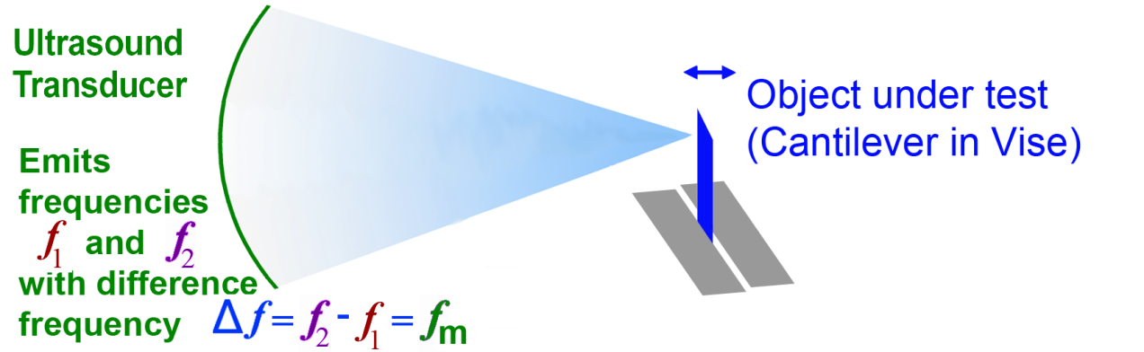
Benefits of using Acoustic Radiation Force for Modal Excitation
Non-Contact and Non Electrical Actuation
Essentially no driver resonances, mass loading, and excitation of fixture modes
Can have focused ultrasound; focal spot of about 2 mm diameter
Questions to be addressed:
  Best method for applying ultrasound?
  What is Force Distribution?

Slide 6
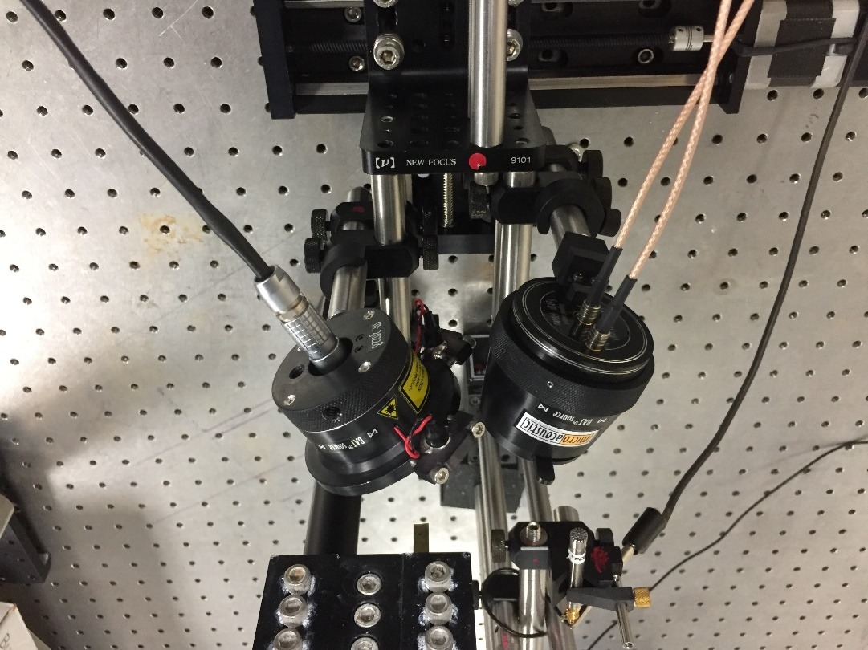
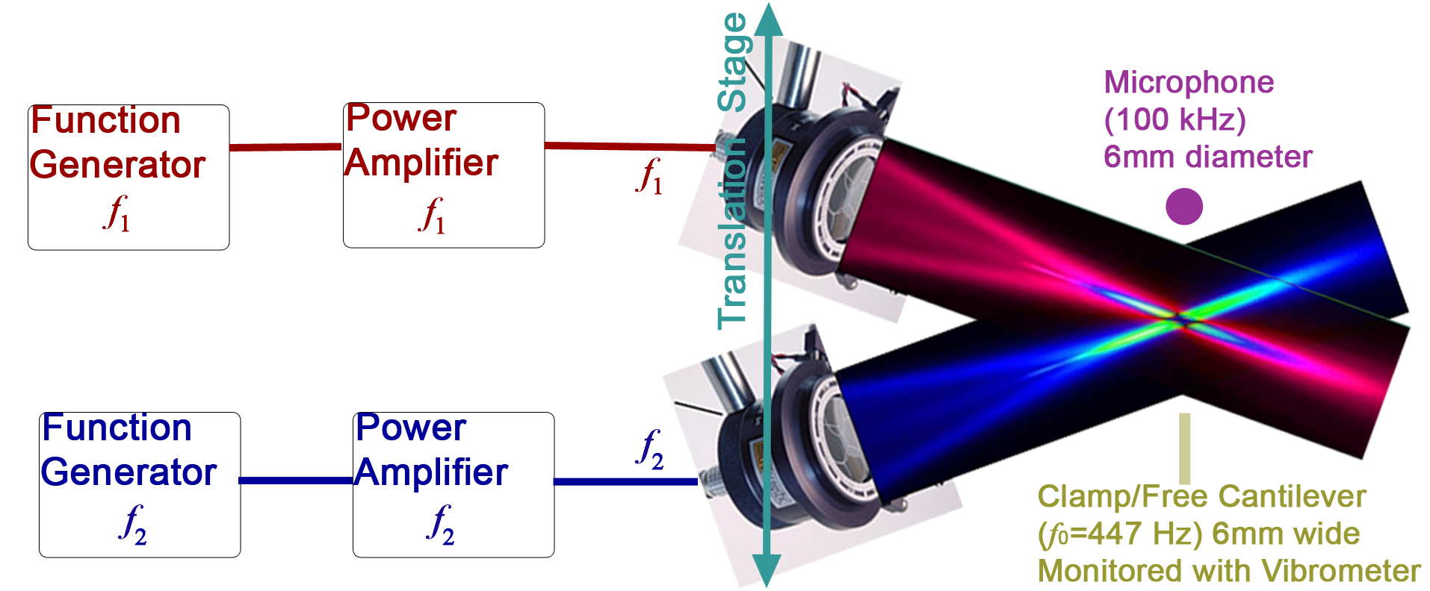
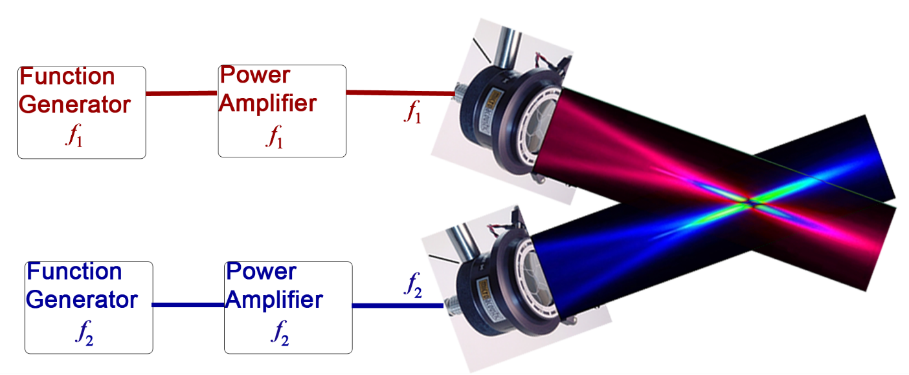
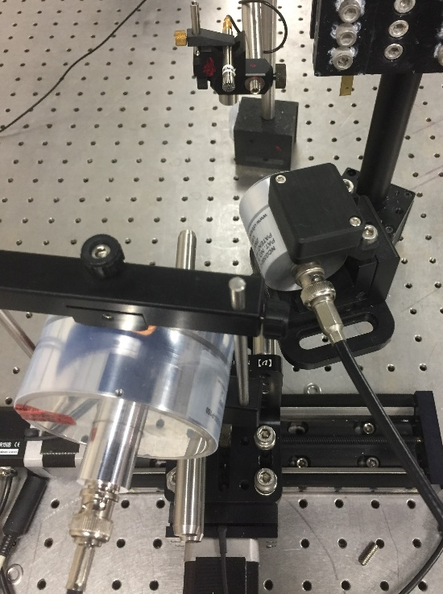
X-Focal: Using Two Separate Ultrasound Transducers
Two transducers driven with separate function generators and amps
  For example: One transducer at 501 kHz and other at 499 kHz
  Each transducer has focal spot size ~ 2mm in diameter
  Frequencies combined only in overlap area of the transducers
Transducers Mounted on Translation Stage
  Monitor excitation using Microphone and Clamped/Free Cantilever
Microphone
Cantilever

Slide 7
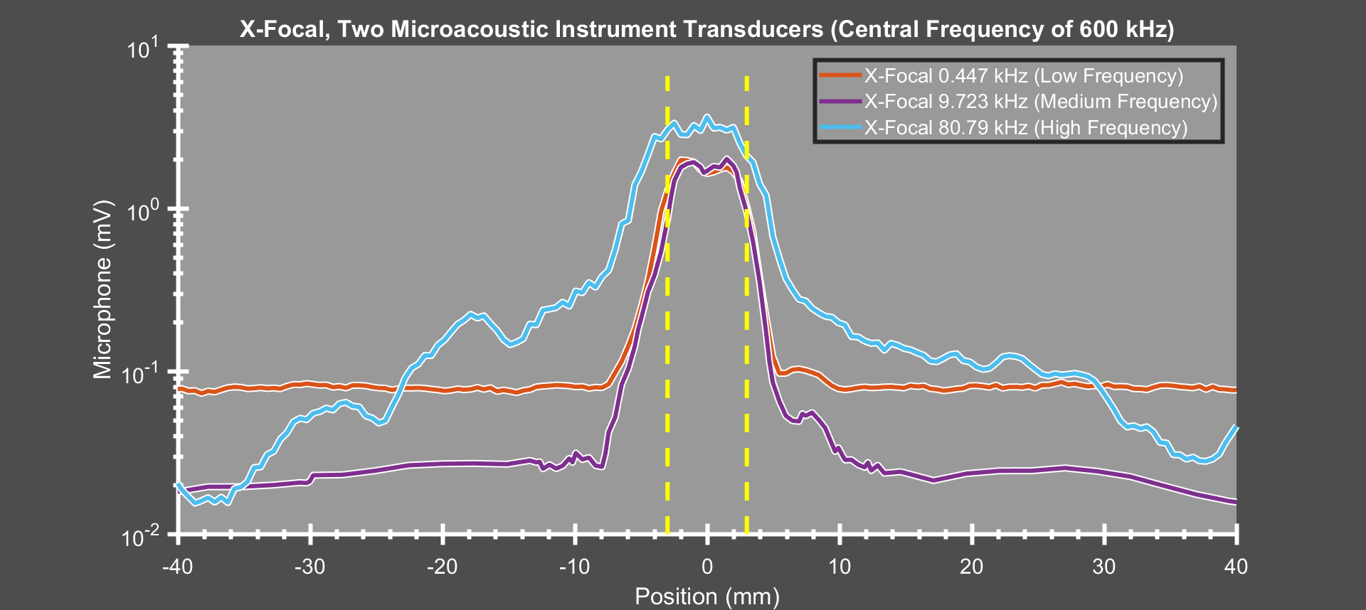
Microphone width of about 6mm (dotted yellow lines), Ultrasound focal diameter of about 2mm
Narrow excitation region with amplitude nearly independent of frequency (Note that y-axis is log scale)
  Frequency response is flat to within about a factor of 2 from 0.4 kHz to 80 kHz (many additional frequencies tested)
  Similar results from different transducers: Microacoustic Instruments (Capacitive Micromachined), Ultran (Piezoelectrc)
X-Focal: Results obtained from Microphone

Slide 8
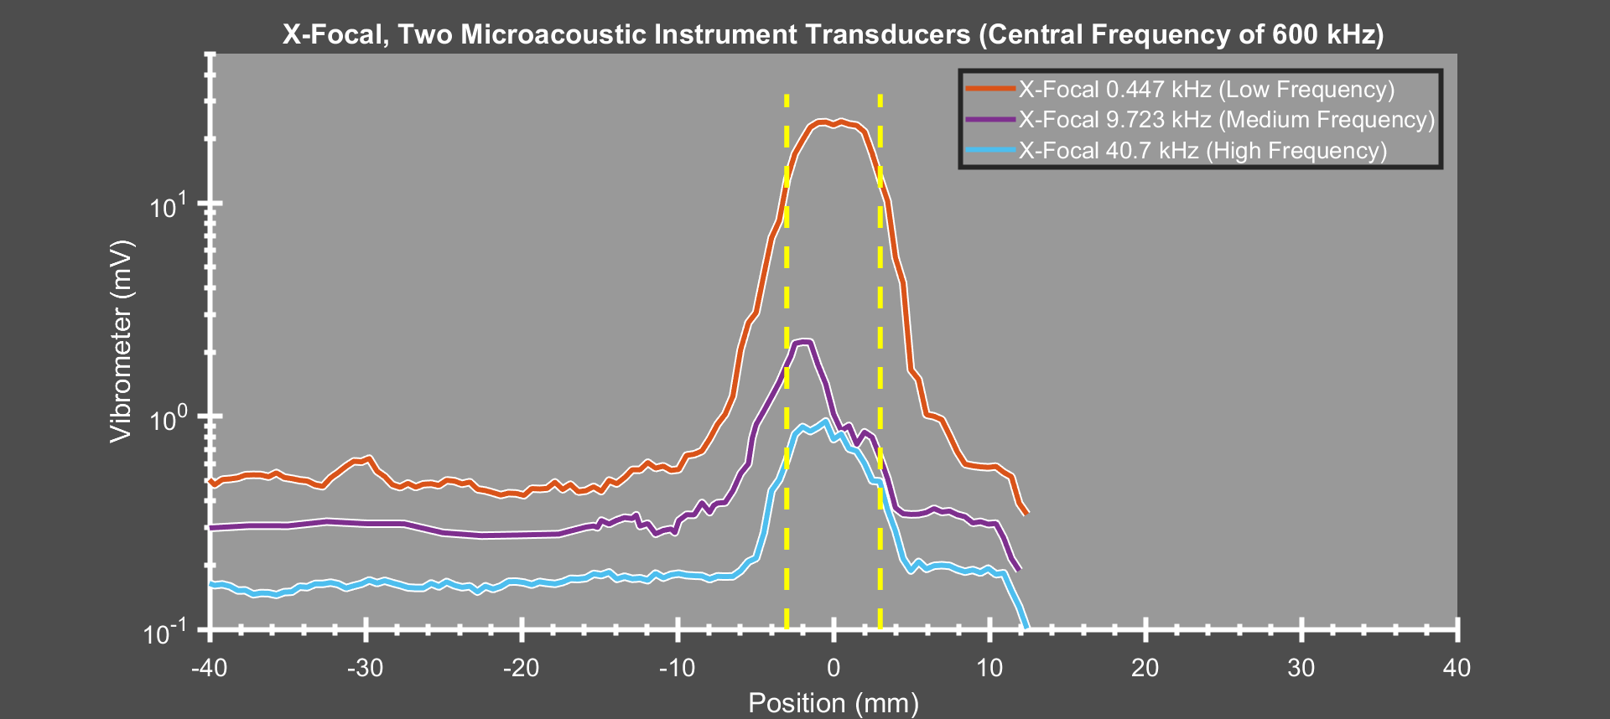
Cantilever with 447 Hz fundamental frequency. Width of about 6mm, Ultrasound about 2mm
Emit ultrasound difference frequency at cantilever resonances: Narrow excitation region
  Amplitude and distribution variations at high frequency because of modal shapes for high-frequency resonances
  Similar results from different pairs of ultrasound transducers
X-Focal: Results obtained from Cantilever (Monitored using a Laser Vibrometer)
Conclusion: Using a pair of ultrasound transducers in X-Focal arrangement
is effective for highly focused, non-contact modal excitation over wide range of frequencies
Downside: Requires pair of transducers and amplifiers, and careful beam alignment

Slide 9
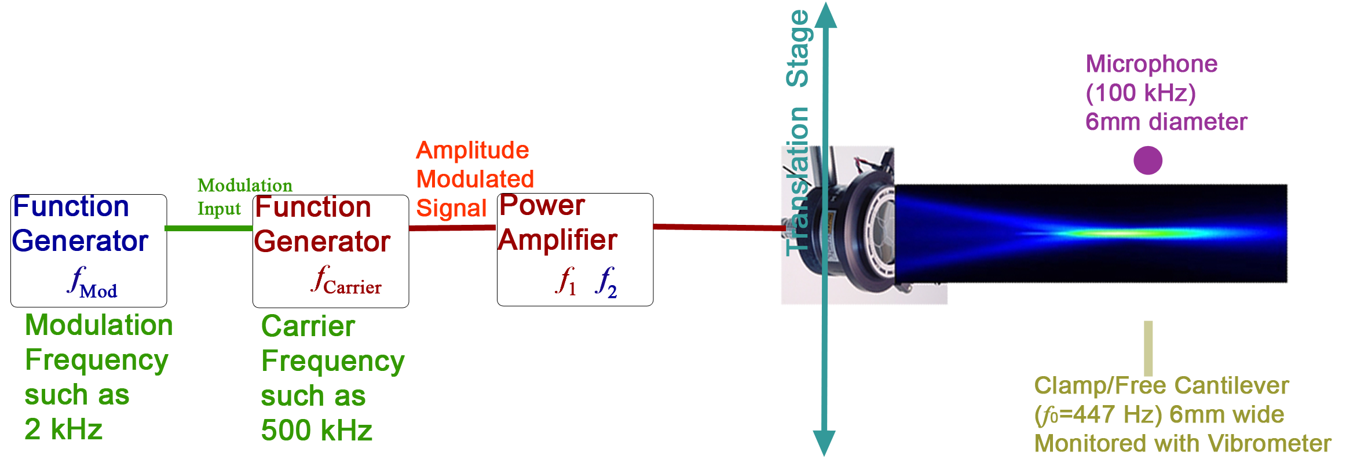
Dual Pair Frequencies
Single Transducer: Amplitude Modulated Signal
1
Dual sideband, suppressed carrier AM modulated signal
  Requires only one power amplifier and transducer
  Does not require alignment of two overlapping transducers
0.9
0.8
0.7
0.6
Amplitude
0.5
0.4
f_{d}
0.3
0.2
0.1
0
85
90
95
100
105
110
115
499 kHz
fc=
500 kHz
501 kHz
Frequency [Hz]
Excitation Signal
Carrier Cycle
Message Cycle

Slide 10
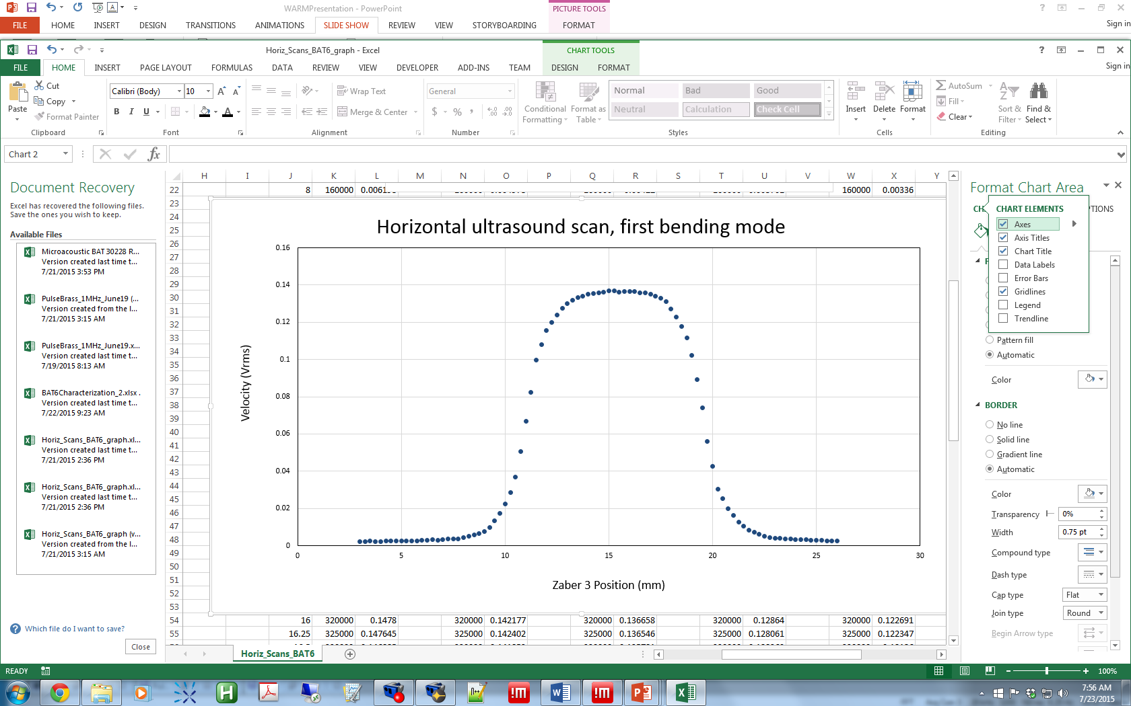
AM Excitation: Results obtained for 447 Hz Fundamental Resonance of Cantilever
Cantilever (6 mm across) vibration monitored at one point with laser Doppler vibrometer
As ultrasound focal spot moves onto the edge, the response acts as a 2D integral of the ultrasound distribution on the cantilever
To obtain the ultrasound distribution from this data, must take the derivative

Slide 11
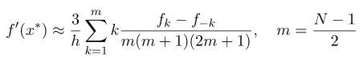
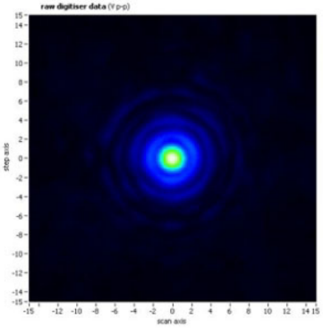
AM Excitation: Determination of line-spread function by moving transducer
Low-noise Lanczos differentiation (N=9)
Each point in the derivative represents the relative sum of a slice of the ultrasound spot distribution.

Slide 12
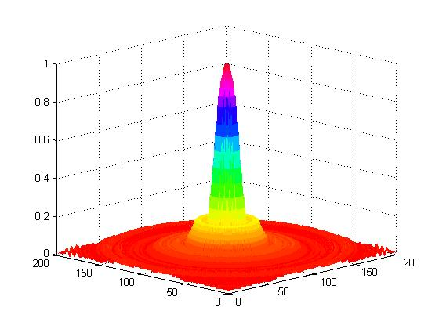
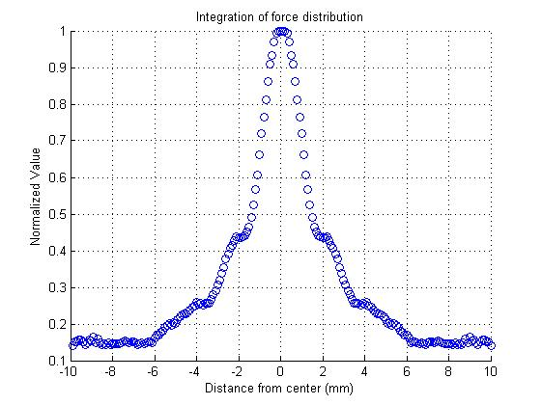
Using Manufacturer’s Pressure Distribution to obtain line-spread function
Radial pressure distribution (slice through middle) from manufacturer rotated to create surface plot of distribution.
Each point is integral of slice of ultrasound distribution
Integrated pressure distribution
Integrate slices through the 2-d distribution

Slide 13
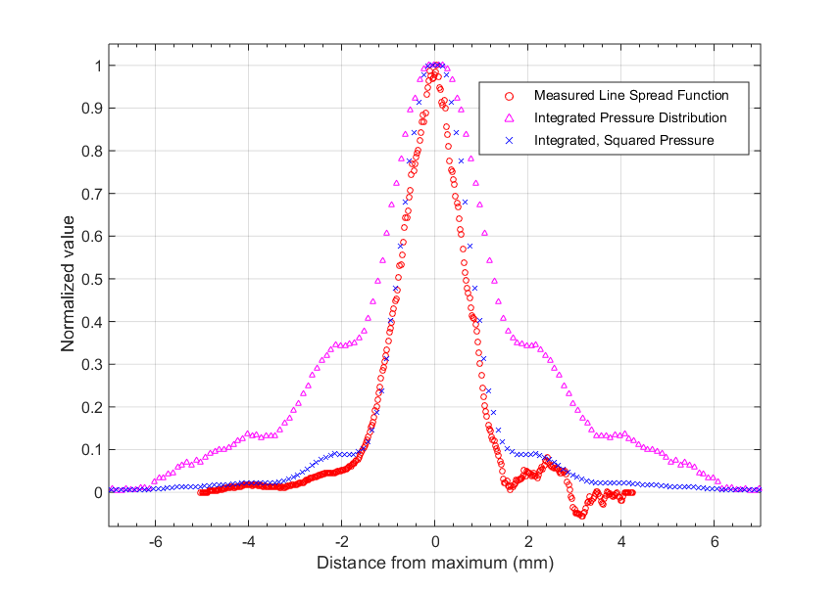
Results: Good agreement between measured and manufacturer’s line-spread function
Red is Measured Line Spread (Vibration as transducer moves across edge)
Magenta is Integrated Pressure Distribution (from manufacturer data)
Blue is Integrated Squared Pressure Distribution (because radiation force proportional to pressure squared)
Agreement between blue and red curves shows that transducer’s ultrasound distribution can be measured with vibrometer as transducer is moved through cantilever edge at 447 Hz

Slide 14
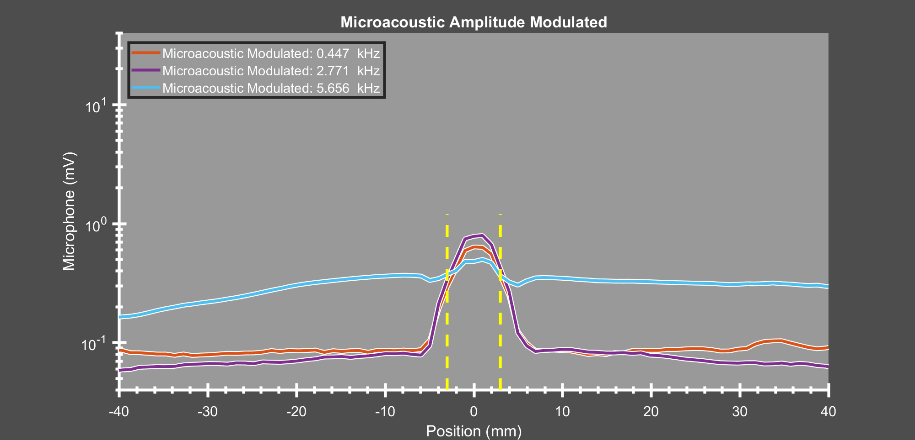
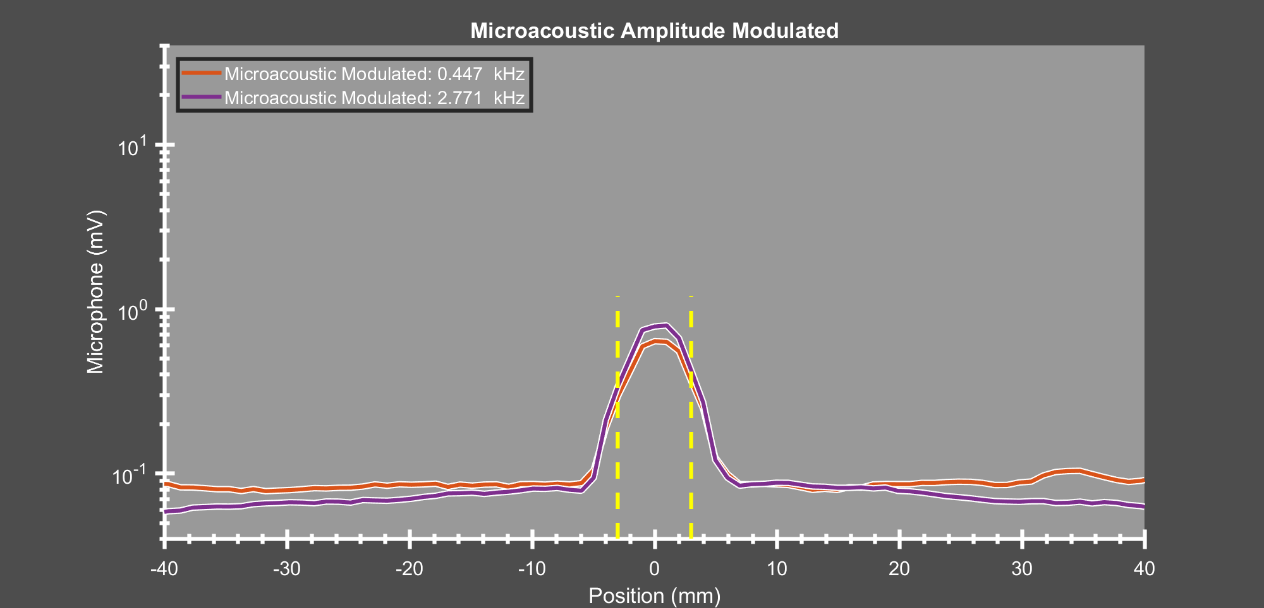
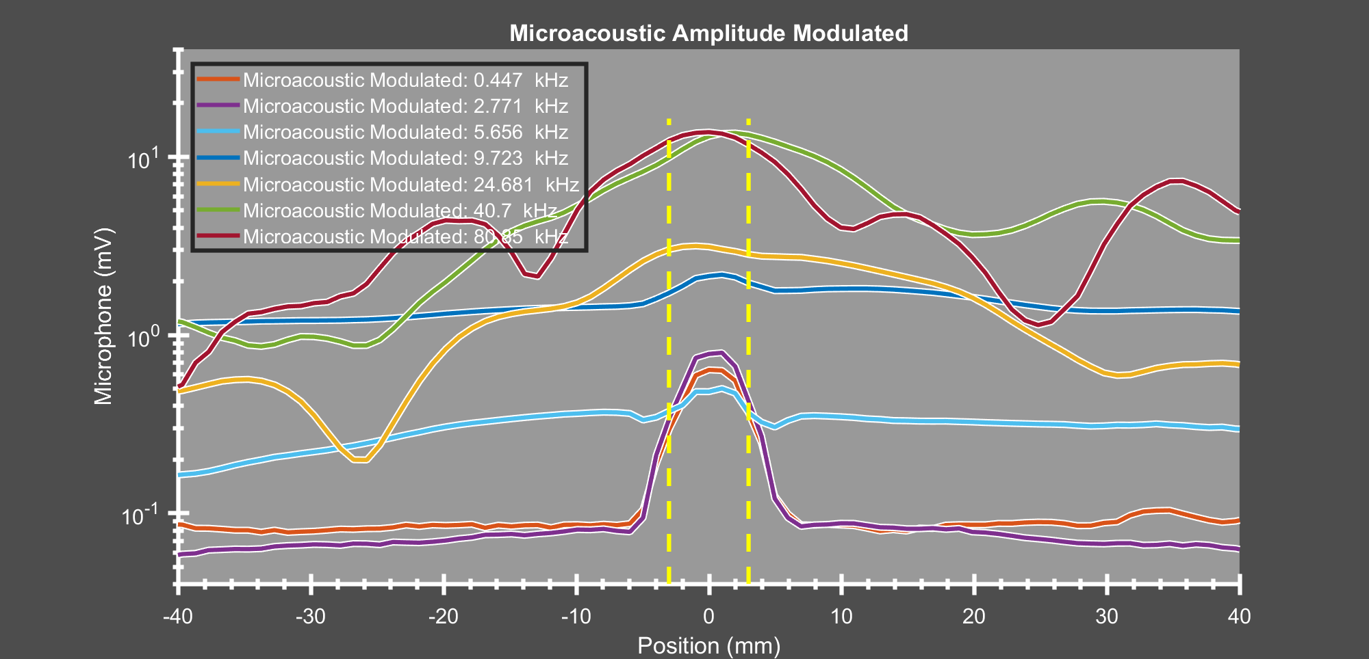
Microphone width of about 6mm (dotted yellow lines), Ultrasound focal diameter of about 2mm
Below ~ 3kHz, narrow excitation region
Higher frequency: Very unexpected, broad frequency distribution!
Amplitude Modulation: Results obtained from Microphone

Slide 15
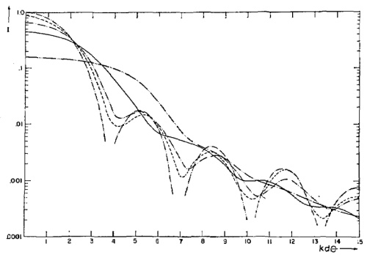
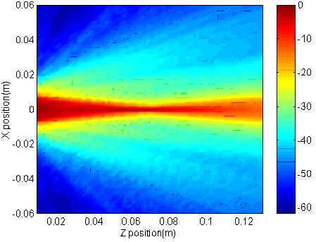
“Normal” Sound from Circular Aperture of Diameter D (Ultrasound Transducer)
First Diffraction Minima at angle Sin⁻¹ (1.22λ/D) = Sin⁻¹ (1.22 c / f D)
Higher Frequency : Smaller angle for first diffraction minima
For difference frequency above ~4kHz, “normal sound” dominates acoustic radiation force
What is the origin of this “normal sound” production
  (Generator, Amplifier, Transducer, air?)

Slide 16
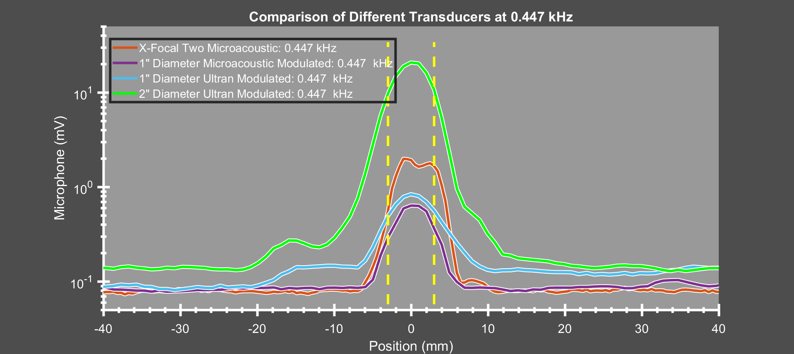
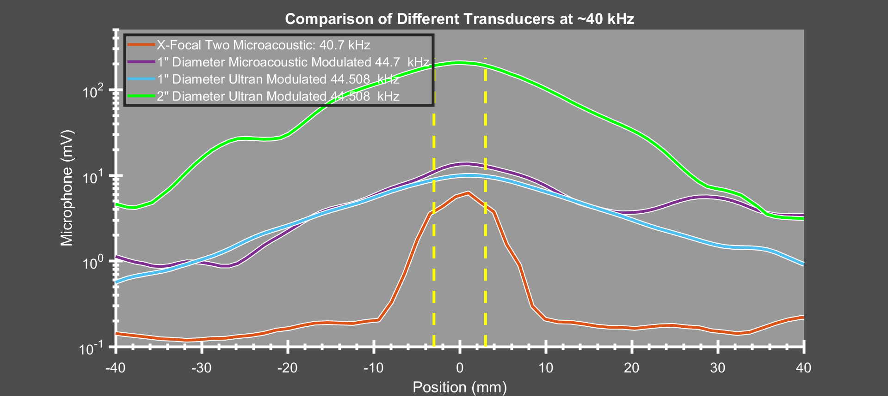
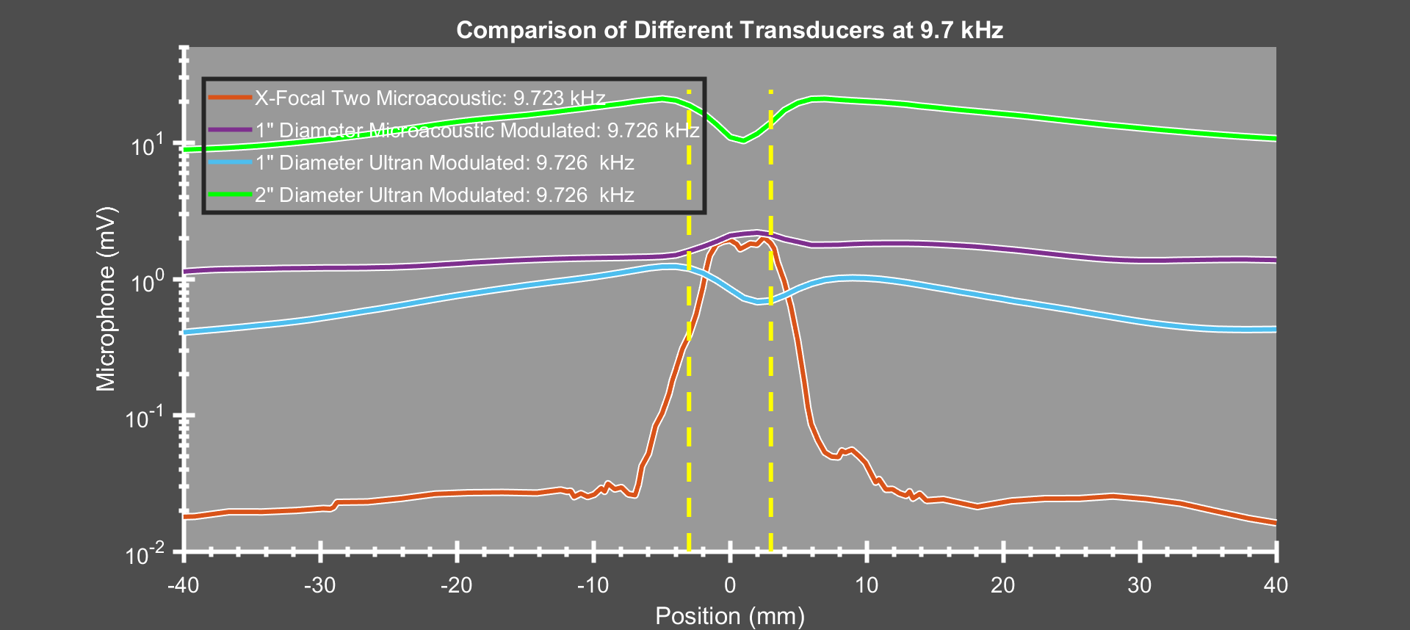
Amplitude Modulation: Results for different transducers
Microphone width of about 6mm (dotted yellow lines), Ultrasound focal diameter of about 2mm
Compare different piezo transducers (1” and 2” Ultran), capacitive micromachined transducer with X-Focal
This “normal sound” production effect appears to be real, and is not just a defective transducer!

Slide 17
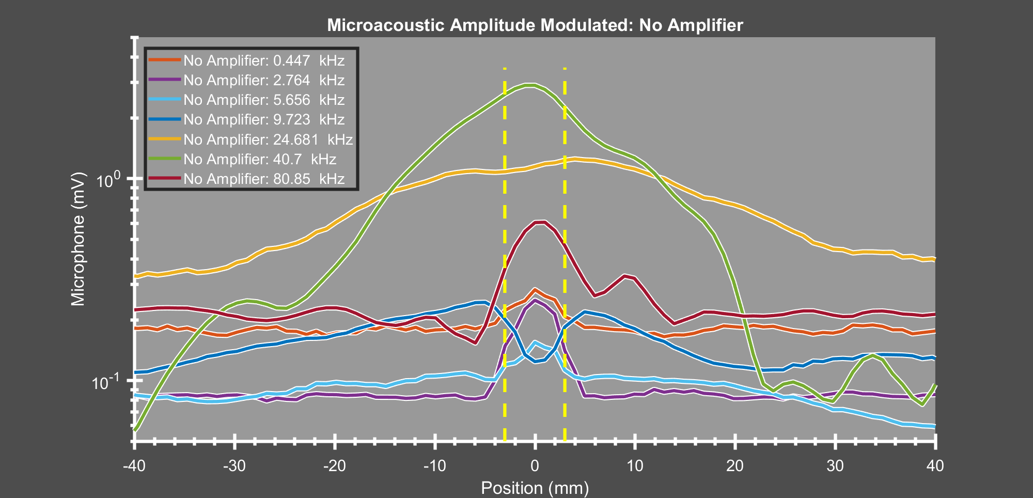
Could there be mixing within the amplifier?
Remove power amplifier: output from function generator directly into transducer
Microphone signal two orders of magnitude smaller; unfortunately
similar broad distribution. Occurs with different transducers and function generators
Amplitude Modulation: Mixing in amplifier or function generator
Excitation Signal
Carrier Cycle
X
Message Cycle

Slide 18
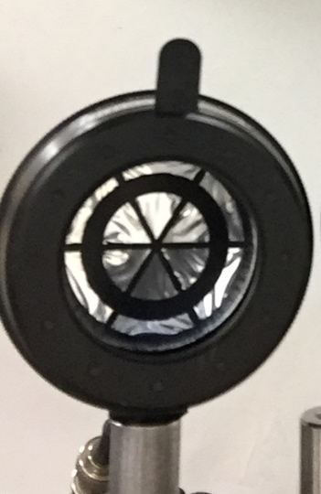
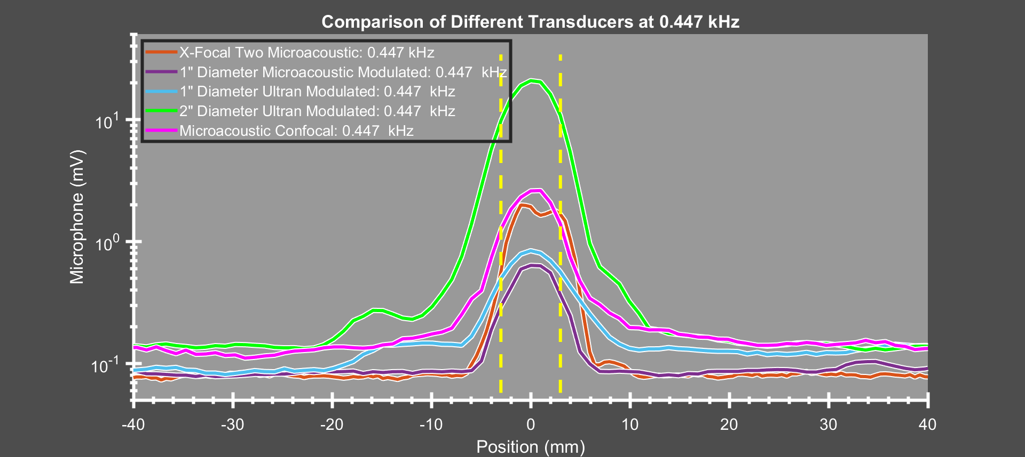
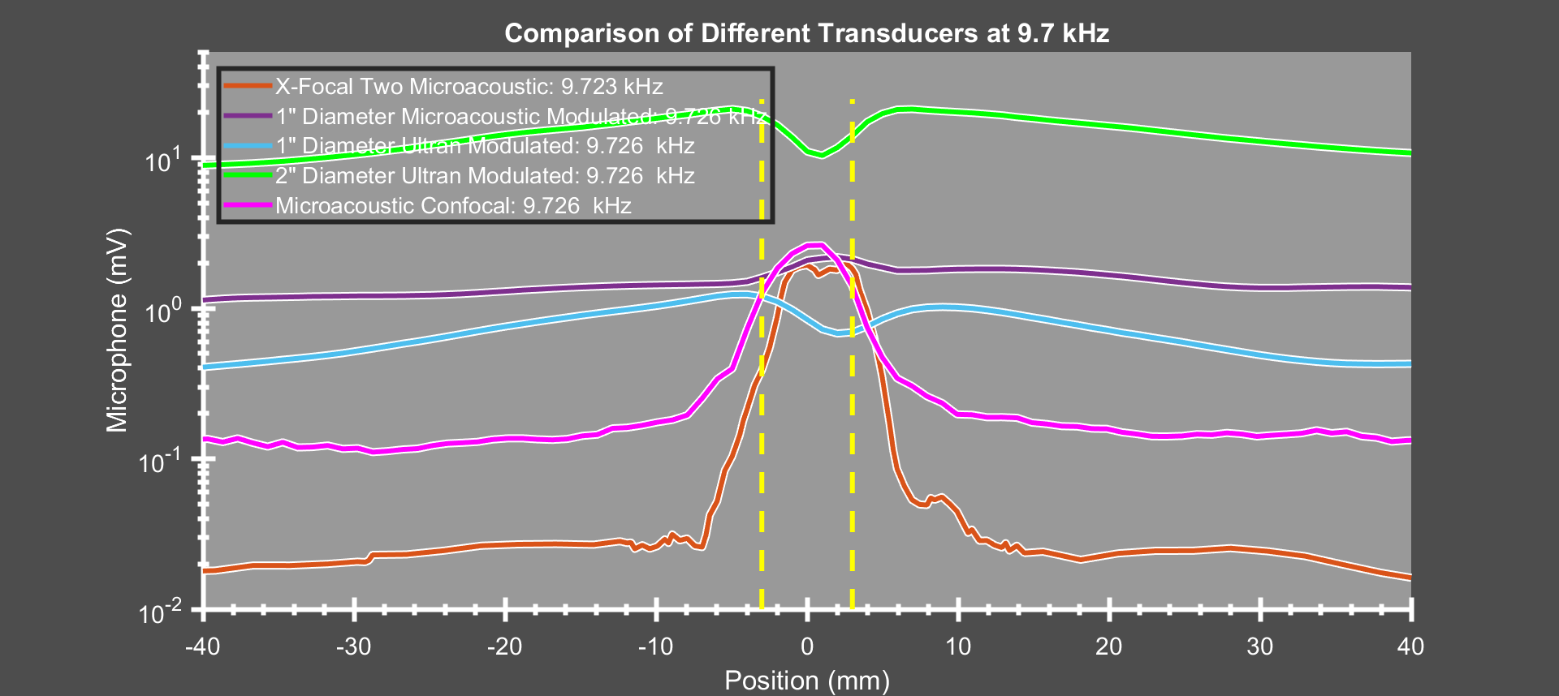
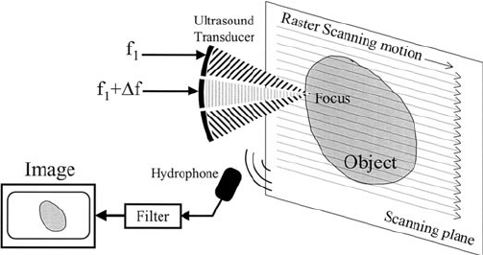
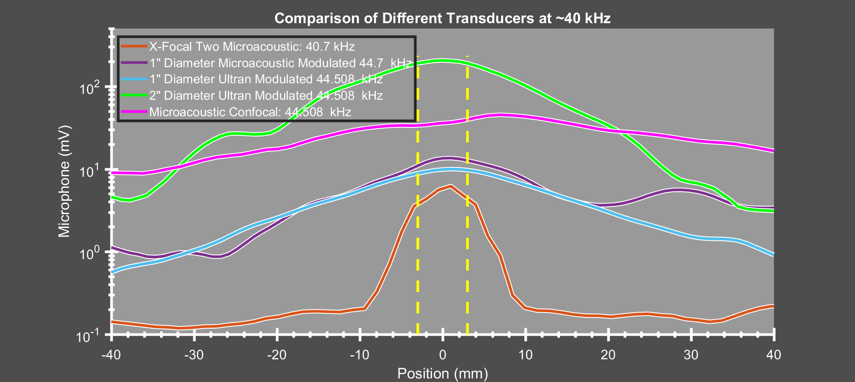
Excitation using 600 kHz Dual-Element Confocal Transducer
Separate function generators and amplifiers for confocal disk and ring
  Common method used for ultrasound excitation in water-based experiments at different labs
Observe same pattern: narrow distribution at low difference frequency
and broad distribution at high frequency
Not amplifier crosstalk: switching same generator/amplifiers to X-Focal pair gives narrow distribution
Something to do with airborne excitation instead of water?

Slide 19

Acknowledgements
Conclusions
Acoustic radiation force can be used for Non-Contact Modal Excitation
  X-Focal pair can produce localized excitation with wide bandwidth and flat response
  Single AM transducer and confocal transducer seem to produce “Normal Sound”
  with a broad distribution when difference frequency exceeds about 4 kHz
  No clear answers on origin of this effect: further studies needed
    Gustavus Acoustics Lab Students including: Will Doebler, Mikaela Algren, and Cole Raisbeck
    This material is based upon work supported by the
    National Science Foundation under Grant Nos. 1300591 and 1635456
    Any opinions, findings, and conclusions or recommendations expressed in this material are those of the authors and do not necessarily reflect the views of the National Science Foundation.
For More Info

