Slide 1
Imaging of propagating wave fronts resulting from ultrasonic pulses incident on heel bones using refracto-vibrometry Acoustical Society of America Meeting Boston, MA June 29, 2017
Thomas Huber
Physics Department, Gustavus Adolphus College, St. Peter, MN
Matthew Huber, Brent Hoffmeister
Physics Department, Rhodes College, Memphis, TN

Slide 2
Introduction
Osteoporosis detection using ultrasound wave propagation through calcaneus heel bone
Refracto-Vibrometry for optical measurement of full-field traveling ultrasonic wavefronts
Visualization of ultrasonic wave interaction with heel bone
Conclusions

Slide 3
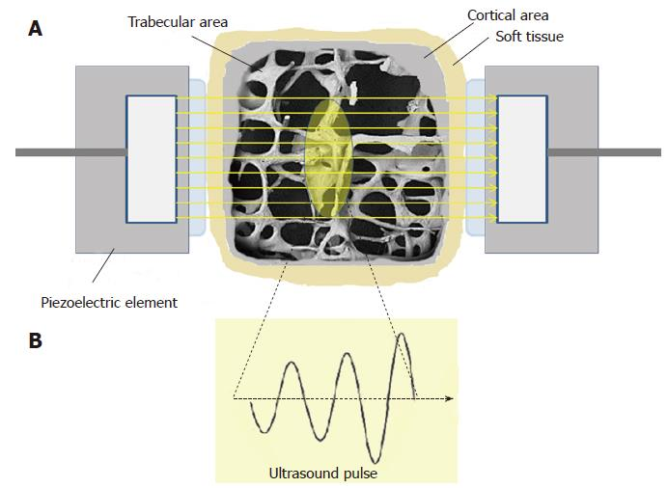
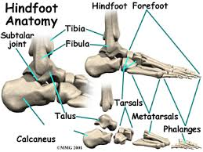
Osteoporosis Screening using Ultrasound Propagation through Heel (Calcaneus)
Speed of ultrasound wave through bone is slightly higher than speed of sound in water
Wave speed depends on bone density and strength, so can be used for detection of osteoporosis
Measure time-of-flight of ultrasonic pulse (launched from water) through bone; detected using 2nd transducer
Commercial ultrasonic heel scanners are an inexpensive, cost-effective method for osteoporosis screening
One research area: accurately characterize bone health using backscattered ultrasound.
This may enable direct testing of back or hip which are difficult to measure with transmission.
Goal of current project: Full-field in vitro measurements to visualize the traveling ultrasonic waves as they interact with the calcaneus (heel bone)

Slide 4
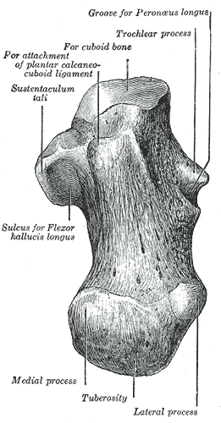
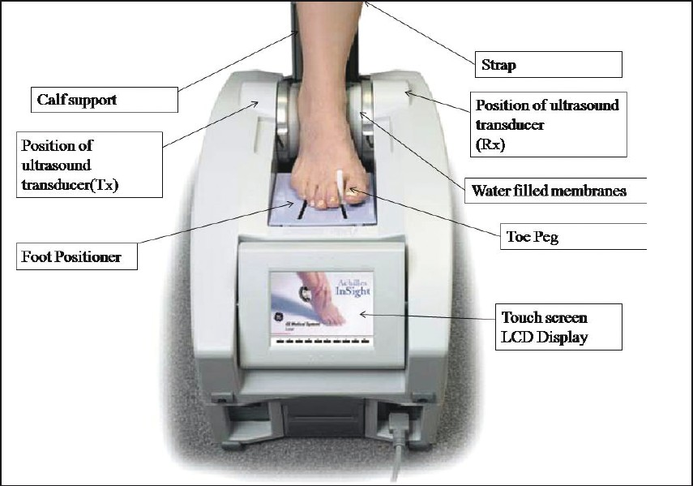
Conventional Ultrasonic Heel Measurements (Piezo Transducers for Transmit and Receive)
Receiver Voltage: After Propagation Through Bone
Ultrasound Transmitter
Ultrasound Receiver
Max: 100 mV
Arrival: 76.5µs
Receiver Voltage: Reference, Bone Removed
Max: 2V
Shift in arrival time and changes in amplitude/frequency can be used to estimate bone parameters
Arrival: 77.8µs

Slide 5
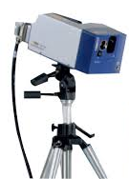
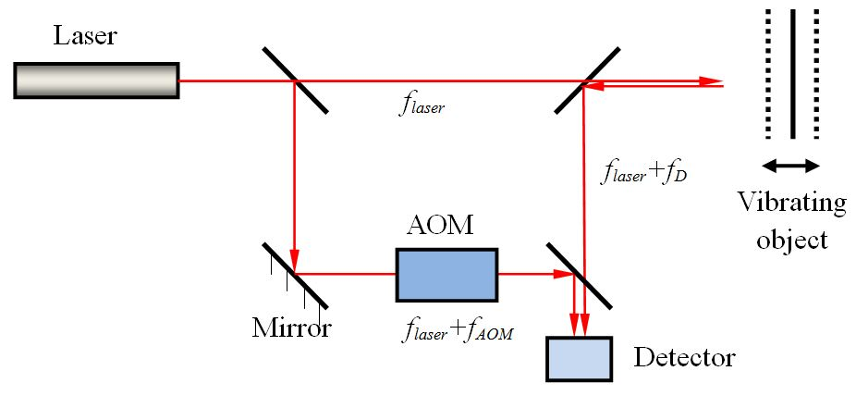
Scanning Laser Doppler Vibrometry
Uses Doppler shift of laser reflected off target surface to measure vibration
Scanning mirrors allows measurement laser to be directed at multiple scan points
Software allows surface plots for visualization of operating deflection shapes
Common method utilized for modal testing
However, we are not going to be talking about vibration measurement today...
We are repurposing the scanning vibrometer to measure ultrasonic waves in water

Slide 6
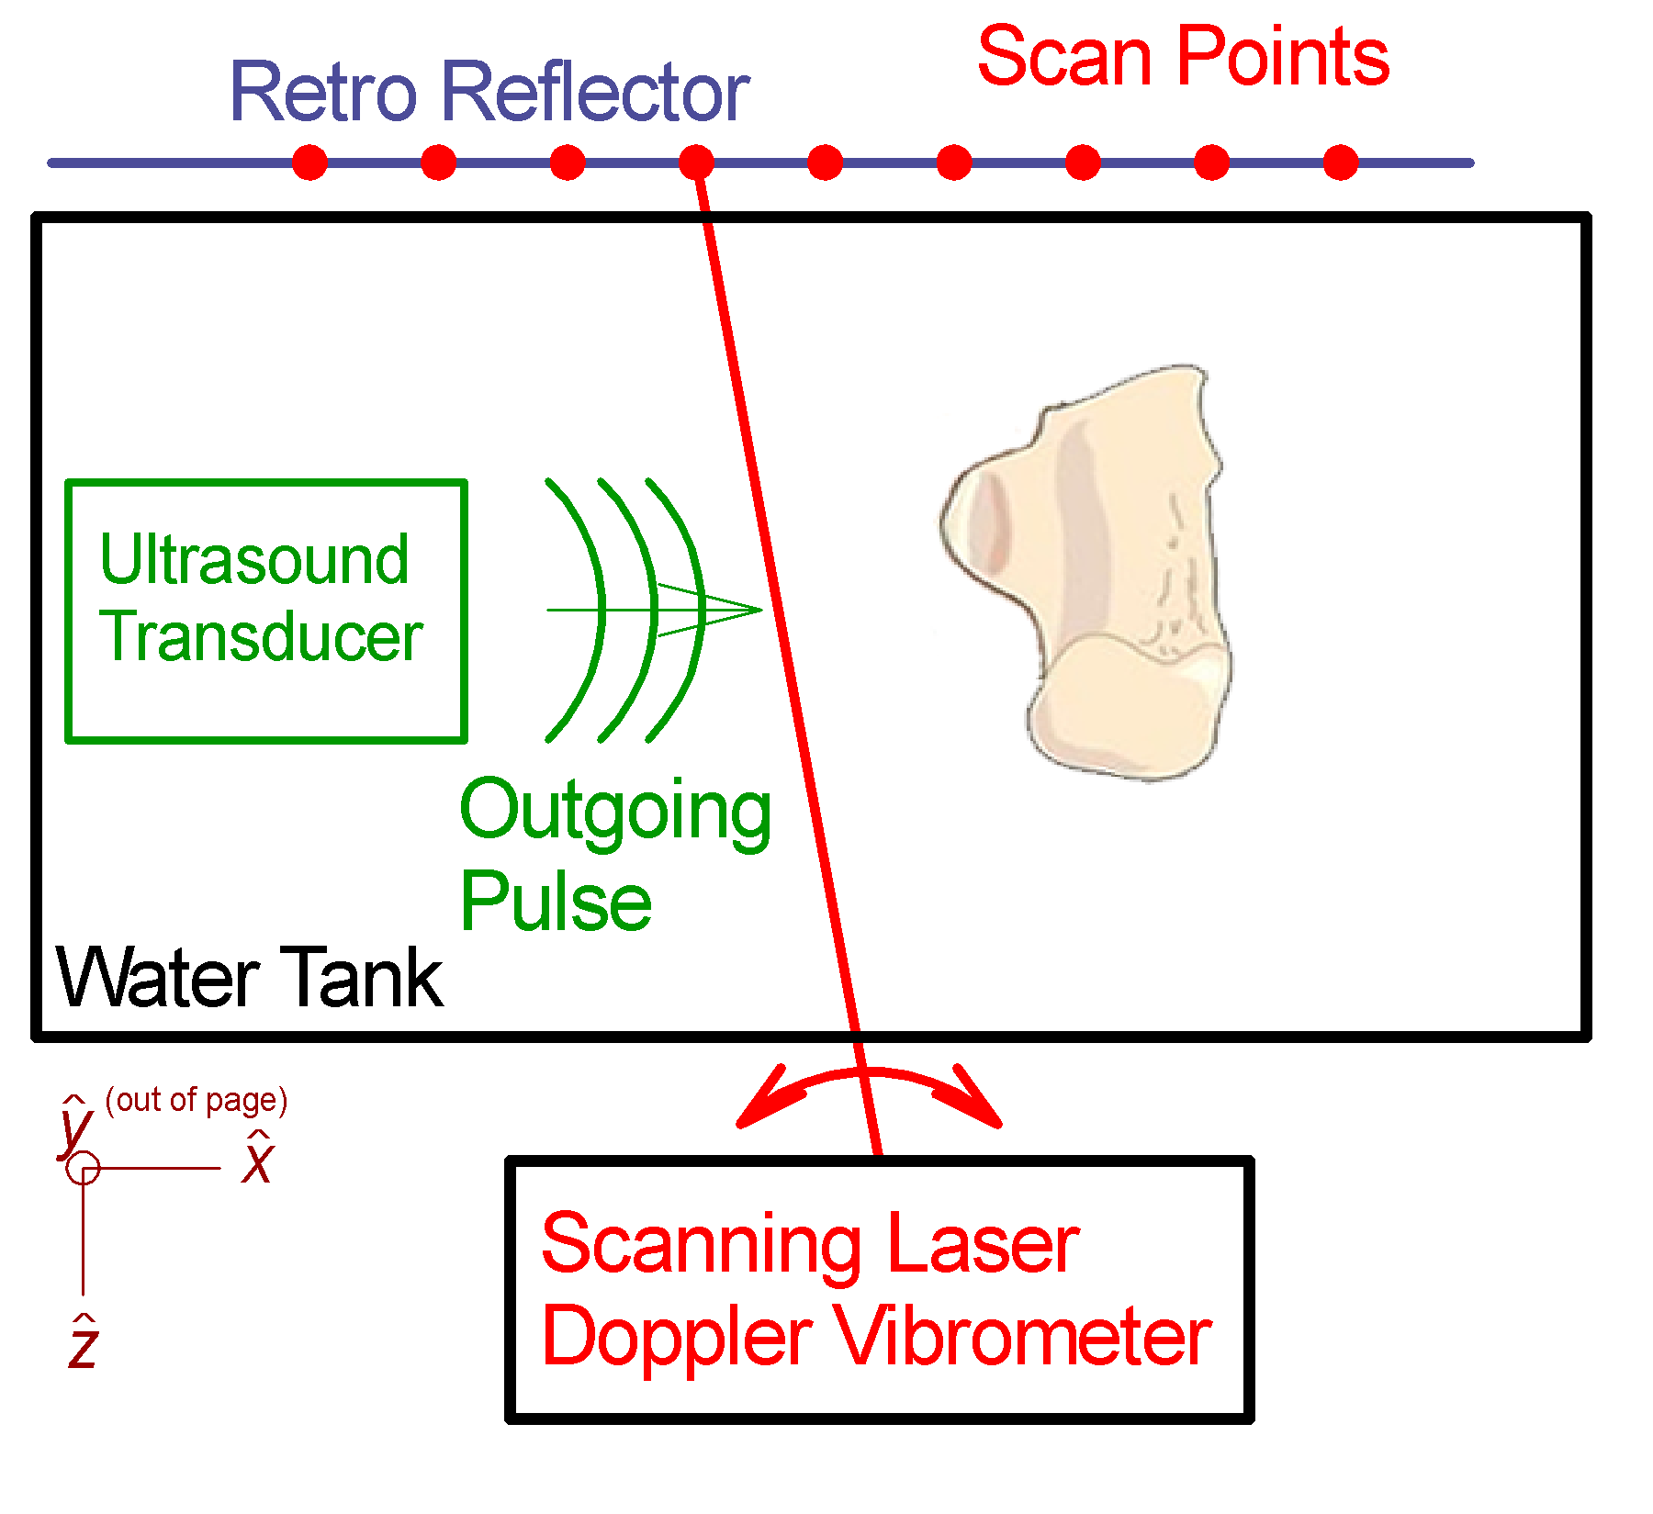
Refracto-Vibrometry: Laser Measurement of Ultrasonic Waves
Sound is a compressional wave: changing density changes the index of refraction
Vibrometer beam (~200µm diameter) passes through tank off retroreflector
When sound wave passes through vibrometer beam, changes the optical path length, ∅
$∅= \int_{path}^{ }{n\left(s\right) ds}$
Although there is no mechanical vibration in the tank, the Polytec vibrometer software interprets and displays the time-varying density as a “deflection shape”
Thus, the scanning vibrometer can be used to visualize traveling ultrasound pulses
Heel Bone

Slide 7
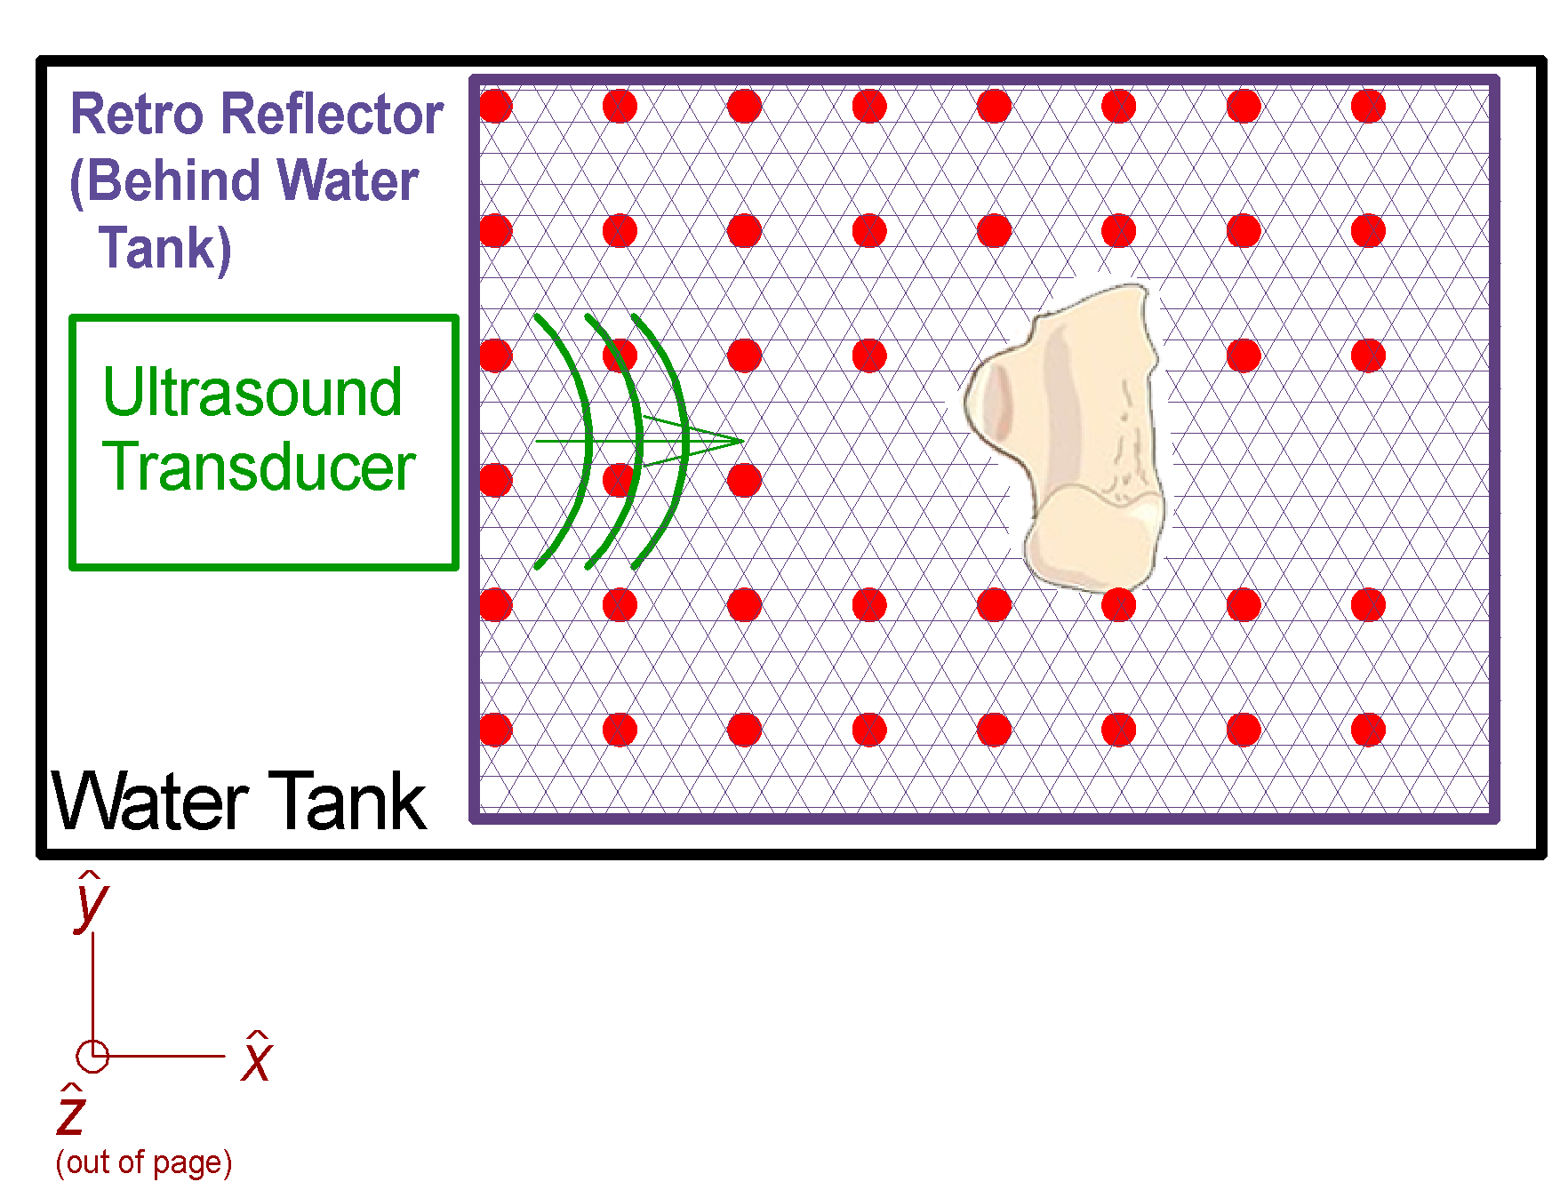
Refracto-Vibrometry for Calcaneus Heel Bone
Top
View
Ultrasound emitted from 500kHZ transducer (on left)
For this measurement, no Receive transducer in tank
Vibrometer beam directed at one of ~15000 scan point locations
Vibrometer signal sampled at 12.8MHz after pulse emission
Average 100 ultrasound pulses at each scan point
Repeat for all 15000 scan points: acquisition time of 2 hours!
Heel Bone
Heel Bone
Vibrometer
View

Slide 8
Potential Advantages of Refracto-Vibrometry
Very high bandwidth (flat response to about 20 MHz)
Non-invasive: no distortions due to receive transducer
Each scan point (about 200µm diameter) is narrow path integral with full time-domain response
Create full-field videos of traveling ultrasonic waves
Top
View
Heel Bone
Vibrometer
View
Heel Bone

Slide 9
Refracto-Vibrometry: For each scan point, full time-domain measurement
Vibrometer Voltage: With Bone In Tank
Max: 40 mV
Scan Point
Arrival: 76.5µs
Vibrometer Voltage: Reference Bone Removed
Max: 5V
1.3 µs shift in arrival time consistent with measurements with piezo receiver
Arrival: 77.8µs

Slide 10
Comparison of Single Refracto-Vibrometry Scan Point and Piezo Transducer
Vibrometer Voltage: With Bone In Tank
Max: 40 mV
Scan Point
Arrival: 76.5µs
Piezo Transducer Voltage: With Bone in Tank
Vibrometer gives similar pulse shape with transducer. Receiver with larger bandwidth and freedom from reflection/damping artifacts

Slide 11
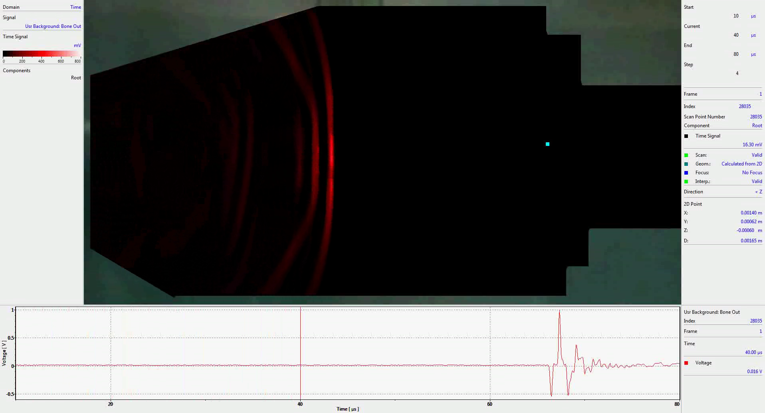
Refracto-Vibrometry Video: Empty Tank (Reference)
Superimposed dataset from 15,000 scan points
Scan Point
Color scaling: Zero volts is black Increasing positive voltage red
(Negative voltages not displayed)
Time-domain measurement at indicated scan point

Slide 12
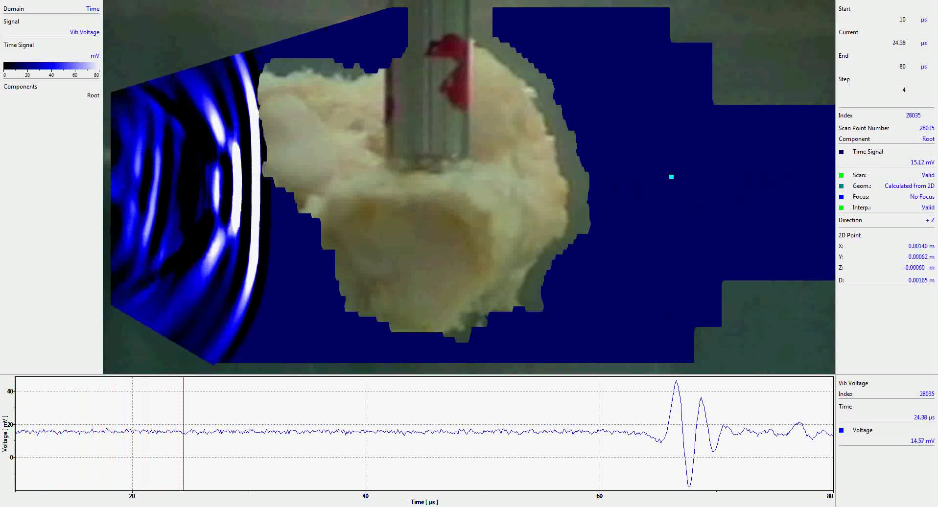
Refracto-Vibrometry Video: With Bone in tank
Scan Point
Color scaling: Zero volts is black Increasing positive voltage blue Over range goes to white
(Negative voltages not displayed)
Time-domain measurement at indicated scan point

Slide 13
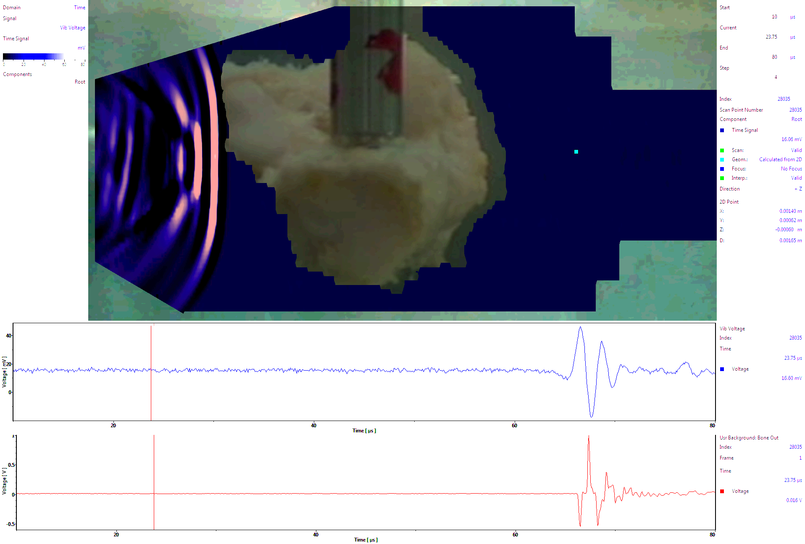
Refracto-Vibrometry: Superimposed Videos
Scan Point
Color scaling: Zero volts is black Red coloration for reference (bone removed)
Blue coloration with bone in tank
Time-domain with bone in place
Time-domain for reference (no bone)

Slide 14
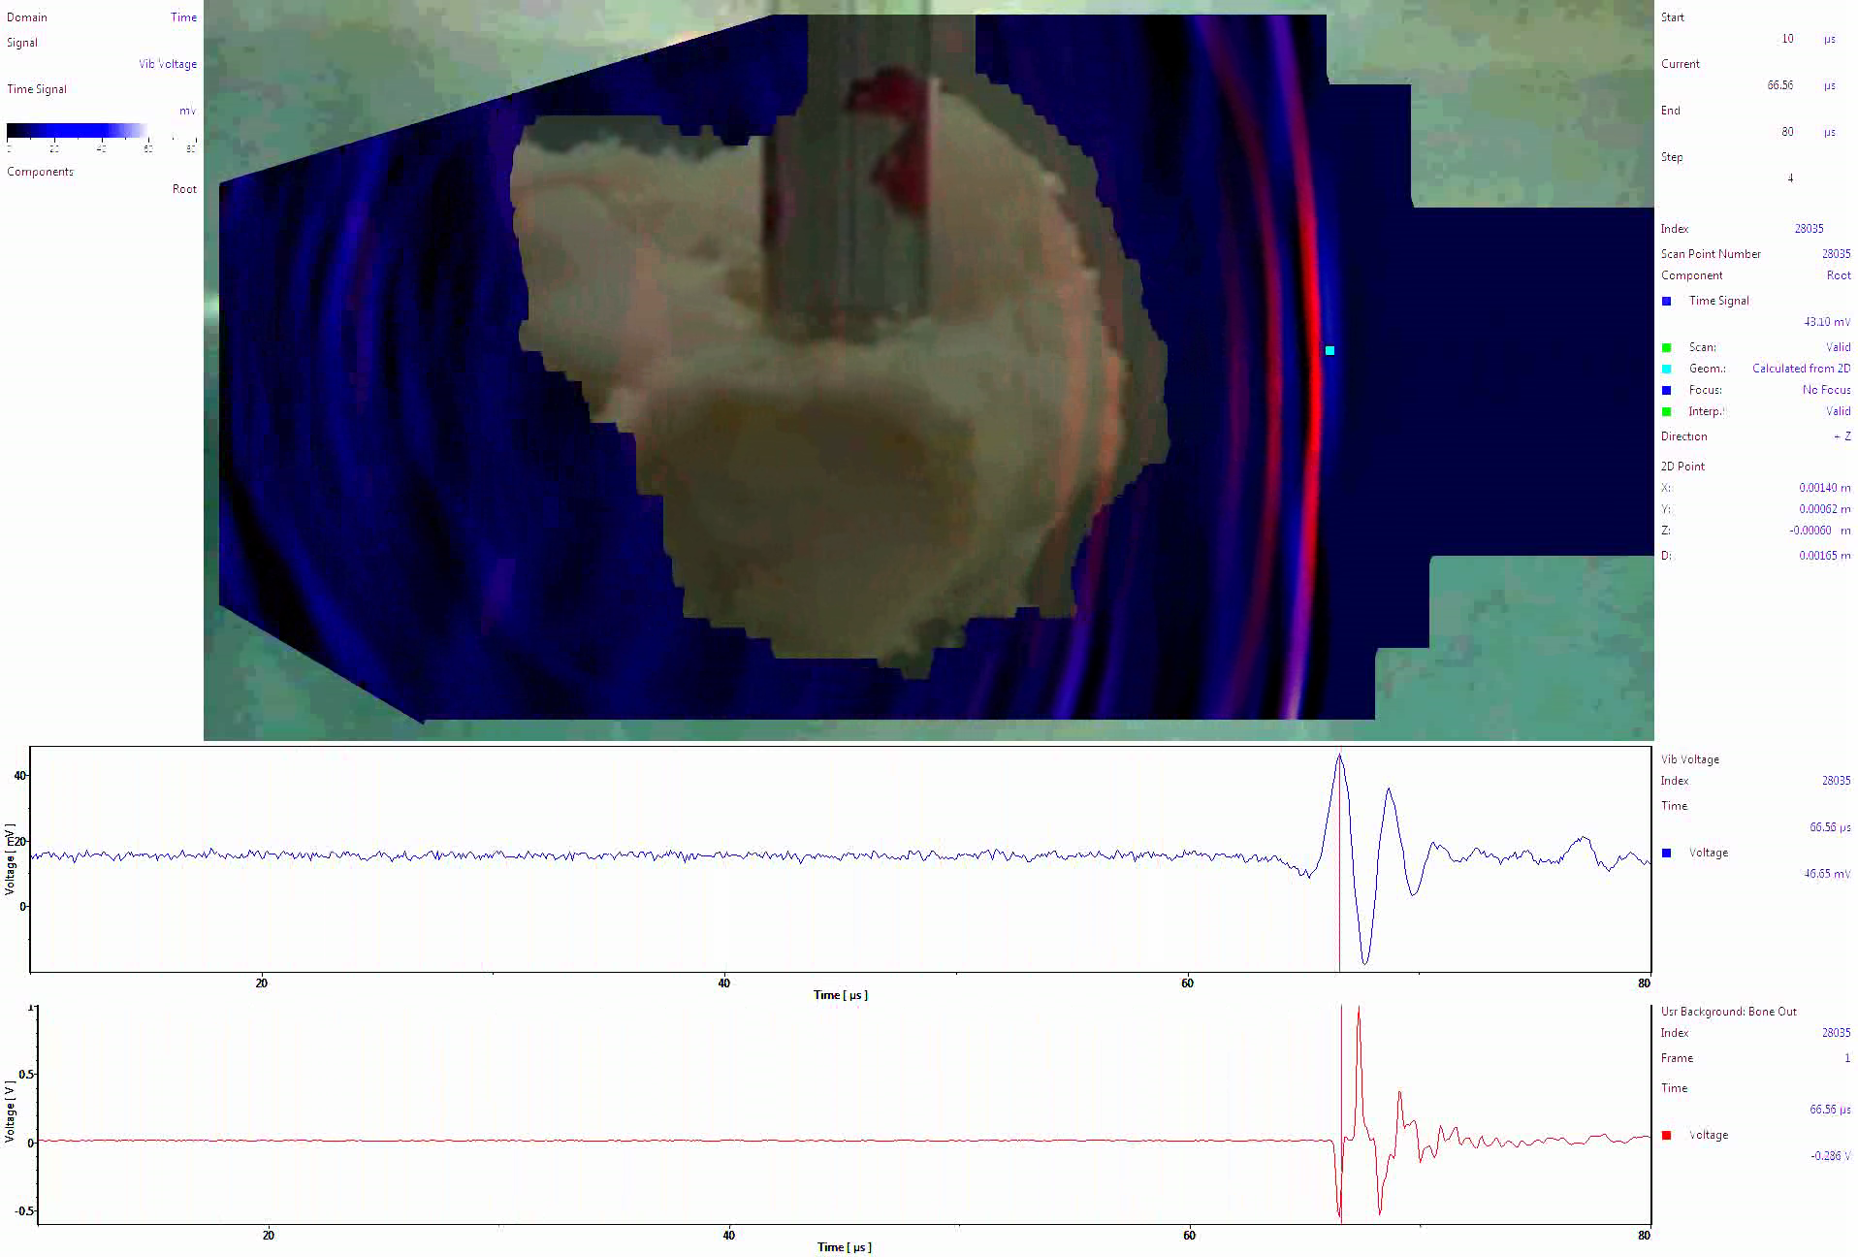
Refracto-Vibrometry: Superimposed Videos
“Red wave” passing through bone is artifact of video overlay
Synchronization of incoming and non-interacting waves
Speed of sound larger in bone than water: blue emerges before red
Emitted wave is planar even though non-uniform thickness; backscatter is non-planar
Time-domain with bone in place
Time-domain for reference (no bone)

Slide 15
Refracto-Vibrometry: Superimposed Videos
Time-domain with bone in place
Time-domain for reference (no bone)

Slide 16
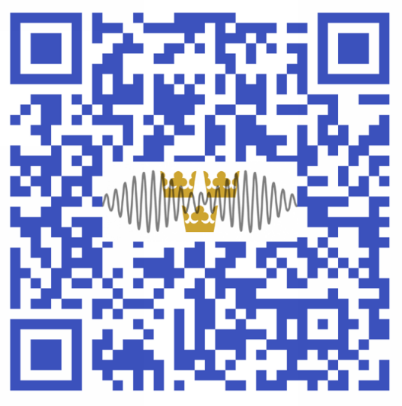
Acknowledgements
Conclusions
Refracto-vibrometry can be used for full-field videos of traveling ultrasound
Non-invasive, quantitative measurements without interference from a receiver
Emitted wave from bone is time-advanced relative to empty target
Time offset is consistent with conventional piezoelectric receiver
Could be utilized for estimates such as speed of sound in bone
Emitted waves are nearly planar
For more info and link to video
on Youtube
Gustavus Physics Students: Matt Mehrkens and Ben Rorem This material is based upon work supported by the
National Science Foundation under Grant Nos. 1300591 and 1635456
Any opinions, findings, and conclusions or recommendations expressed in this material are those of the authors and do not necessarily reflect the views of the National Science Foundation.

